Slide 1

fuelling the change
TM
Presentation @ Hydrogen Summit 2024 by Peter Enå – CEO Hydri AB

Slide 2
Our mission is not a vision
What: We bring Renewable Hydrogen to the users of Zero Emission Vehicles
Why: Fossil fuels needs to be replaced for rapid decarbonisation
How: By implementing a nation-wide renewable hydrogen infrastructure
What:
Why:
How:

Slide 3
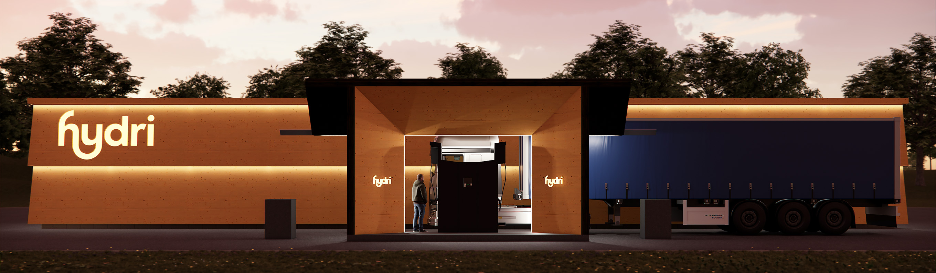
Hydri hydrogen refuelling stations
Focus on heavy freight and long-distance transports
Hydrogen capacity at each station up to 2 000 kg per day
Will serve both 350 and 700 bars vehicles

Slide 4
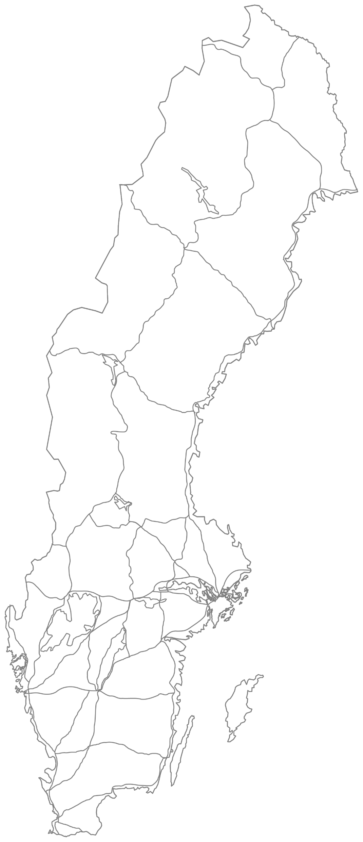
New infrastructure becomes a reality
Hydri rolls out a base network of 24 refuelling stations
Goes into operation in H2 2024 and H1 2025
Aiming for additional 14 stations in H2 2025

Slide 5
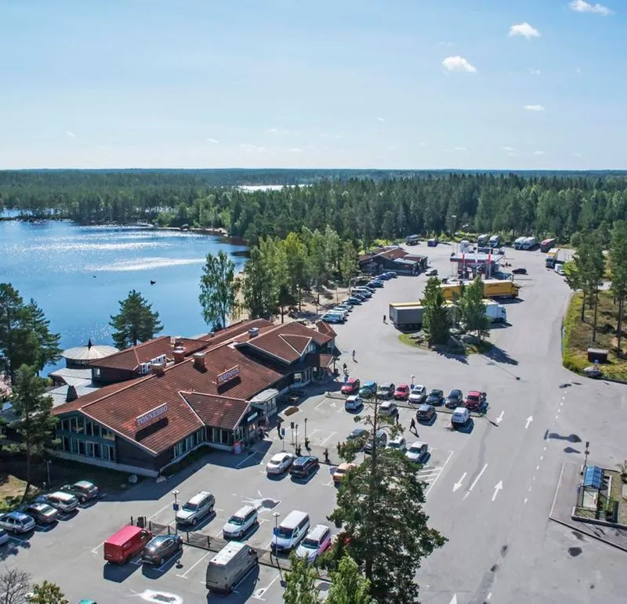
Hydri stations in well-known locations
Our hydrogen stations are mainly built in connection with Rasta's service facilities
Rasta is Sweden's largest truck stop, which is visited daily by about 15,000 heavy vehicles at well-known locations along our major roads and natural junctions

Slide 6
Breaking the catch 22 situation
No refuelling stations
No hydrogen vehicles
No demand for hydrogen

Slide 7
Breaking the catch 22 situation
No refuelling stations
No hydrogen vehicles
No demand for hydrogen
No hydrogen volumes
No decarbonisation
No fossil independence

Slide 8


About Hydri
Founded in 2020. Head office in Gothenburg
Head owned since 2021 by private investor Qarlbo and FAM
Projects partly financed by Klimatklivet at Naturvårdsverket

Slide 9
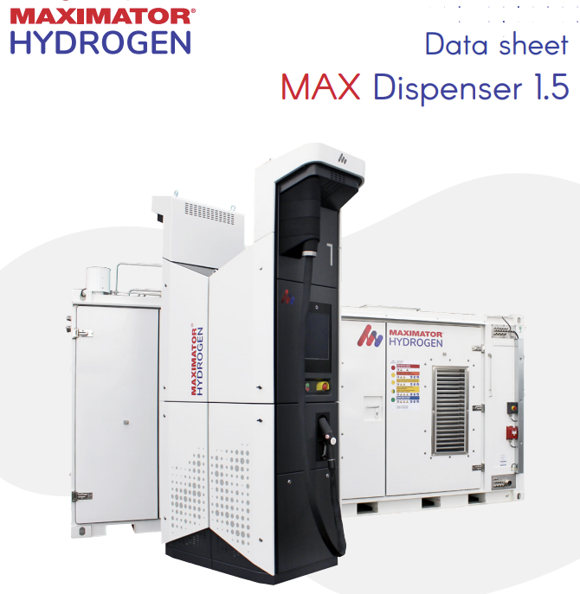
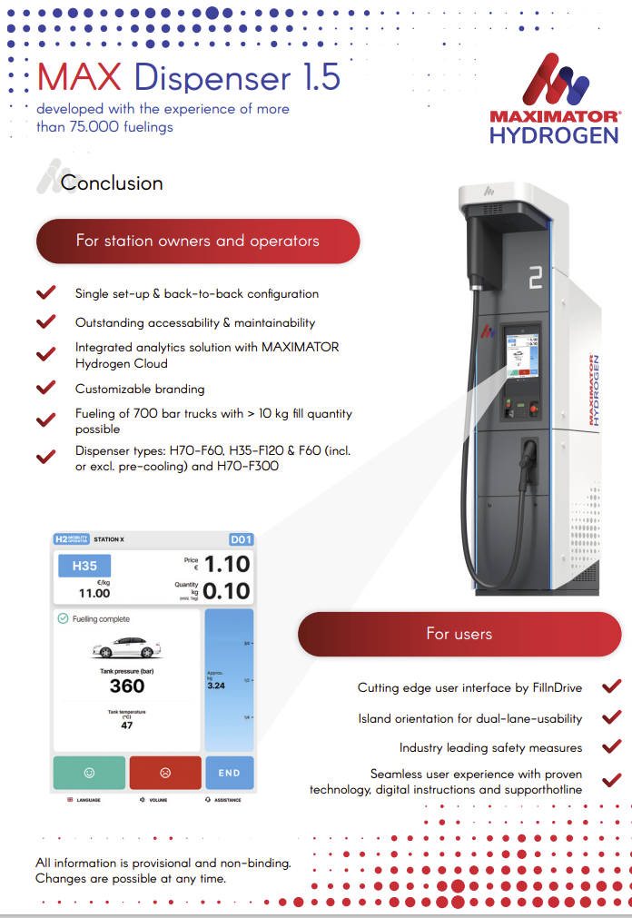
Cooperation with proven technology supplier

Slide 10
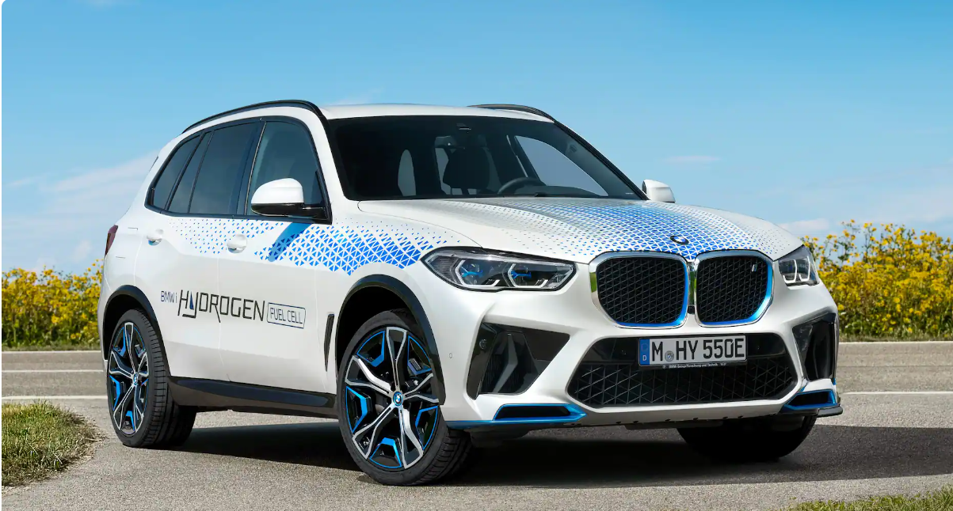
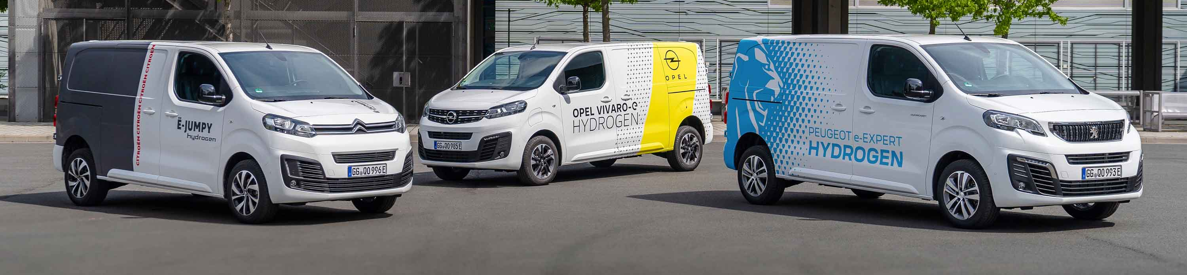
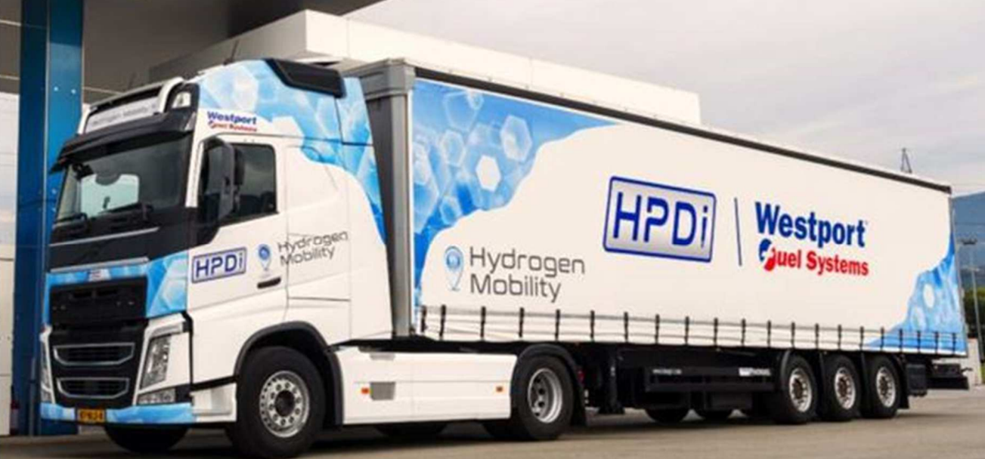
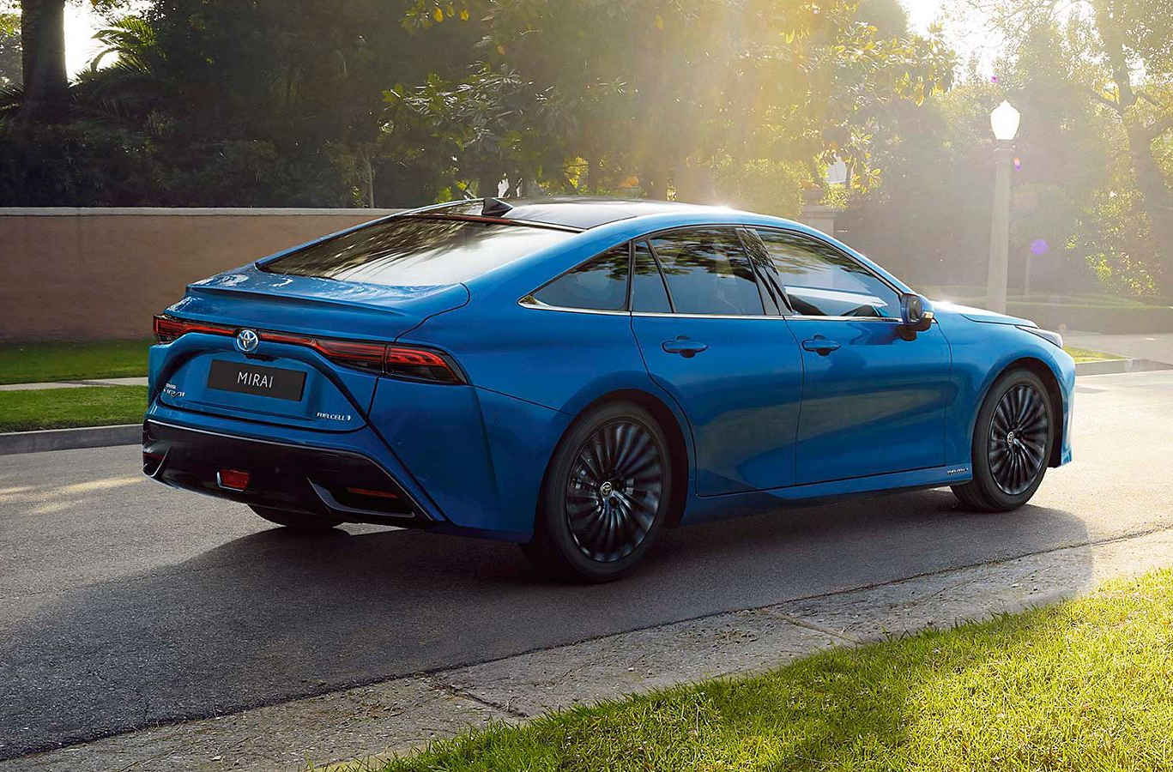
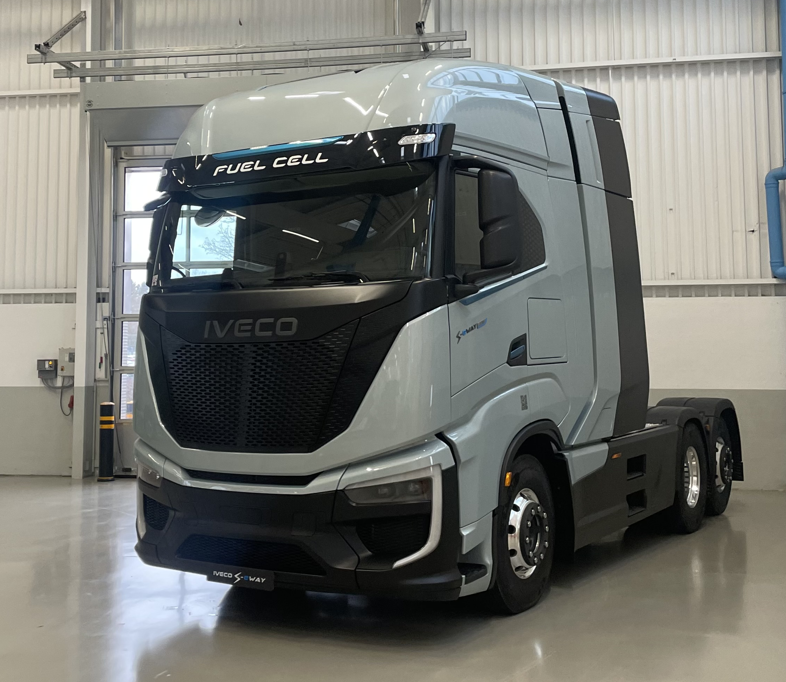
Market development with OEMs and Transport companies

Slide 11
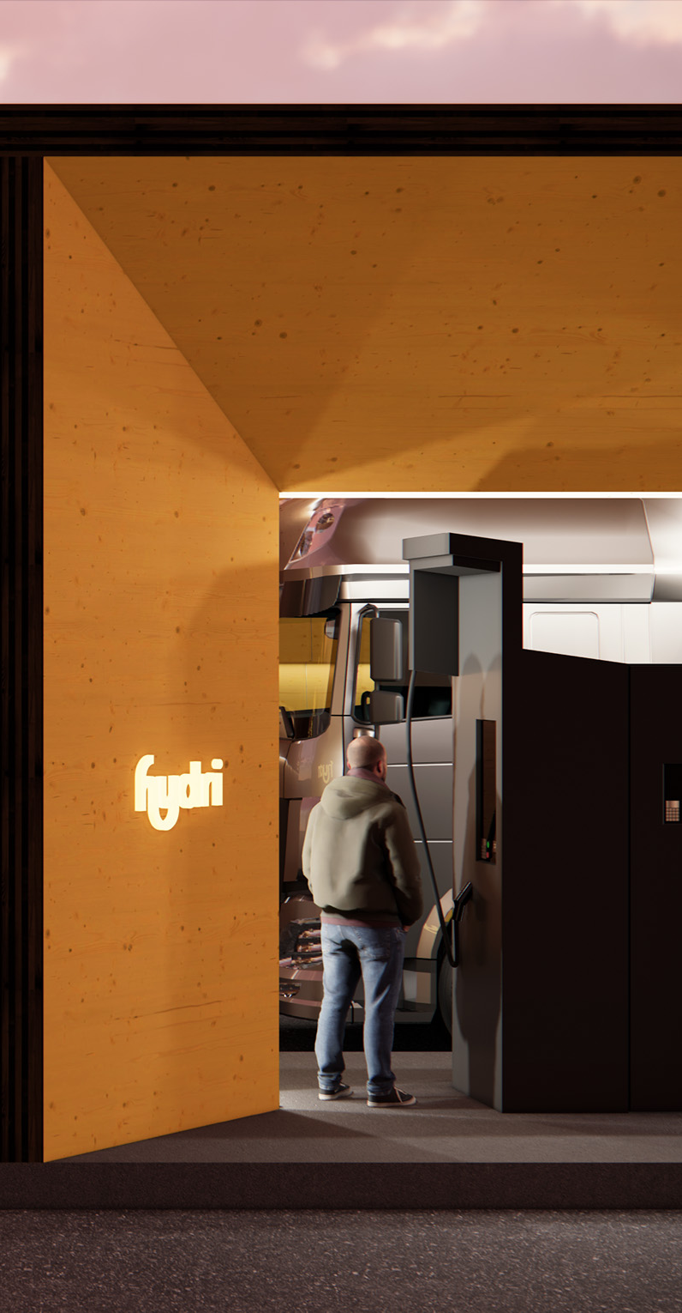
Immediate impact on the environment
Each kg hydrogen replace 4 L fossil fuel and saves 11 kg CO2
Enables a full transition to zero emission heavy duty trucks
Hydrogen is not dependent and limited by the grid capacity

Slide 12
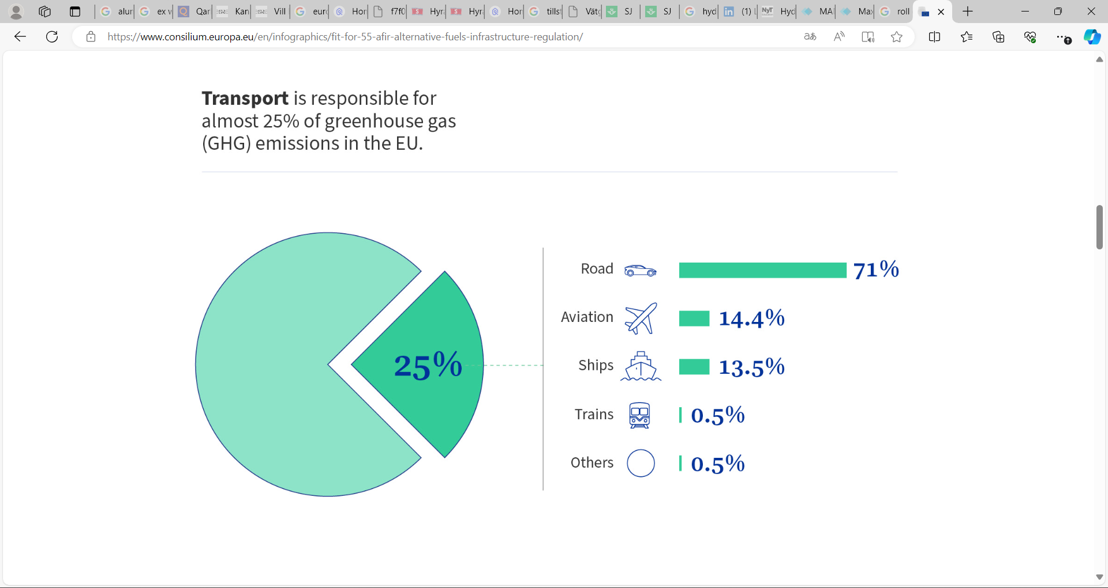
EU regulation - AFIR for stations in 2030
Request at least one station every 200 km on main roads
Request at least one station in every urban node
Provide a capacity of min 1 tonnes hydrogen per day at 700 bar

Slide 13
EU regulation for reduced road emissions
Reduce GHG with 45% to 2030 for road vehicles
Requires 400 000 zero emission vehicles according to ACEA*
Requires 4 200 hydrogen stations in EU and 70 in Sweden
* ACEA, the European Automobile Manufacturers’ Association, unites Europe’s 15 major car, truck, van and bus makers

Slide 14
State support for successful implementation
National CAPEX and OPEX supports are key for the hydrogen road transport sector and fulfilment of AFIR
Support Production for 2 TWh hydrogen capacity in 2030 via national fund or bank like in Germany and Denmark or IRA in USA
Support Refuelling Stations to reduce low volume prices from 2025 until demand passes over 250 kg per day per station

Slide 15
fuelling the change
TM
Presentation @ Hydrogen Summit 2024 by Peter Enå – CEO Hydri AB

