Slide 1
En ”gigafabrik” för ledande industriella elektrolysörer för grön vätgasproduktion
2024-05-14
Christer Wikner, CEO

Slide 2
En ”gigafabrik” för ledande industriella elektrolysörer för grön vätgasproduktion Hur möter vi kommande förväntade behov av elektrolysanläggningar och fossilfri vätgas? Vilka är nycklarna för att få i gång den fossilfria vätgasmarknaden? En industriell möjlighet för Sverige?
2024-05-14
Christer Wikner, CEO

Slide 3
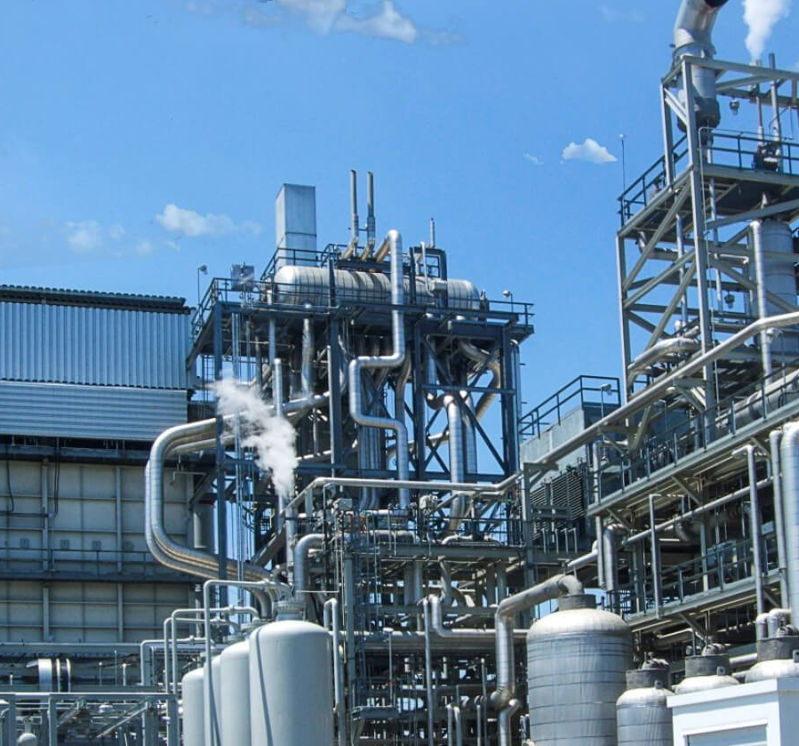
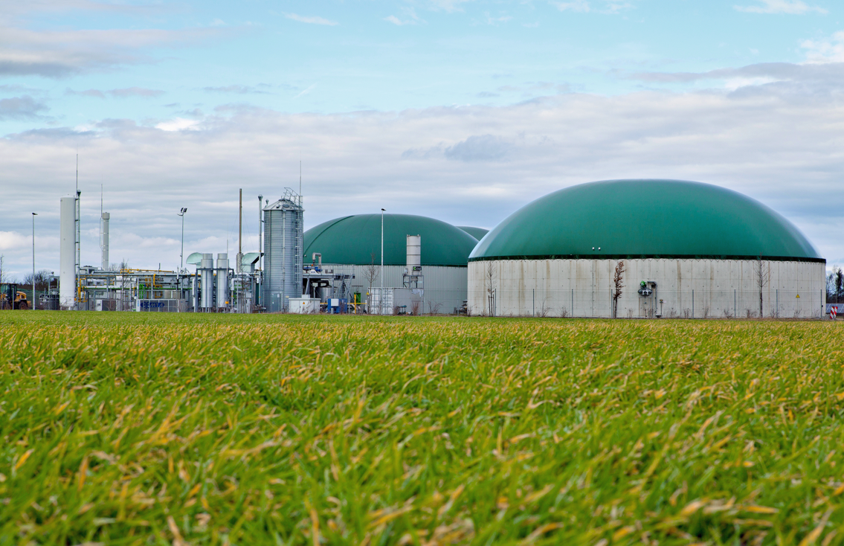
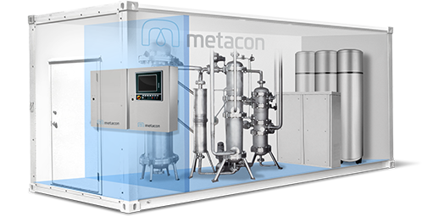
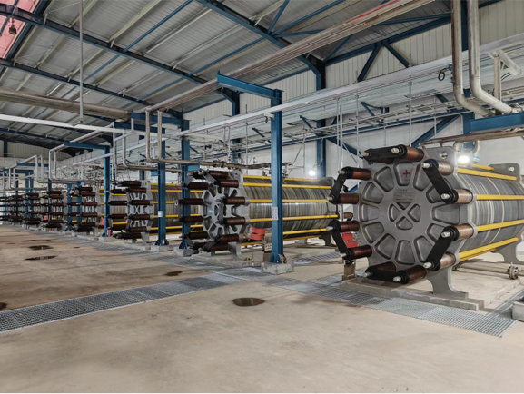
Metacon is about overcoming hurdles in traditional hydrogen production
PRODUCT STRATEGY
Traditional natural gas reforming is massive scale, dirty and polluting…
…while Metacon offers affordable green hydrogen production on site
Inaccessible and not economically justified for local production and use
Decentralized green hydrogen from reforming and electrolysis
Reformers
Electrolyzers
1
Fossil hydrocarbons, often natural gas, used in steam reforming
1
Reduced CO2 emissions through catalytic reforming process, removes open flame
1
Green hydrogen production using electricity generated from renewable energy²
Requires large and capital-intensive process facilities
2
Multi-fuel compatible including biogas
2
Zero emissions when used with green electricity
2
Improved efficiency compared to traditional reformers
3
3
Costly and complex transportation to point of application
Decentralized (on site) and smaller facility required, fits in standard-sized containers
3
Compact systems enables swift installation
4
4
Containerized and non-containerized options, modular for any system size
4
High capex requirements and need for continuous flow of fossil hydrocarbons
5
Carbon neutral/negative¹
6
Production of up to 600 kg H₂/day
5
Synergistic complement to renewable energy, offering option for energy storage
Source: Company information.

Slide 4
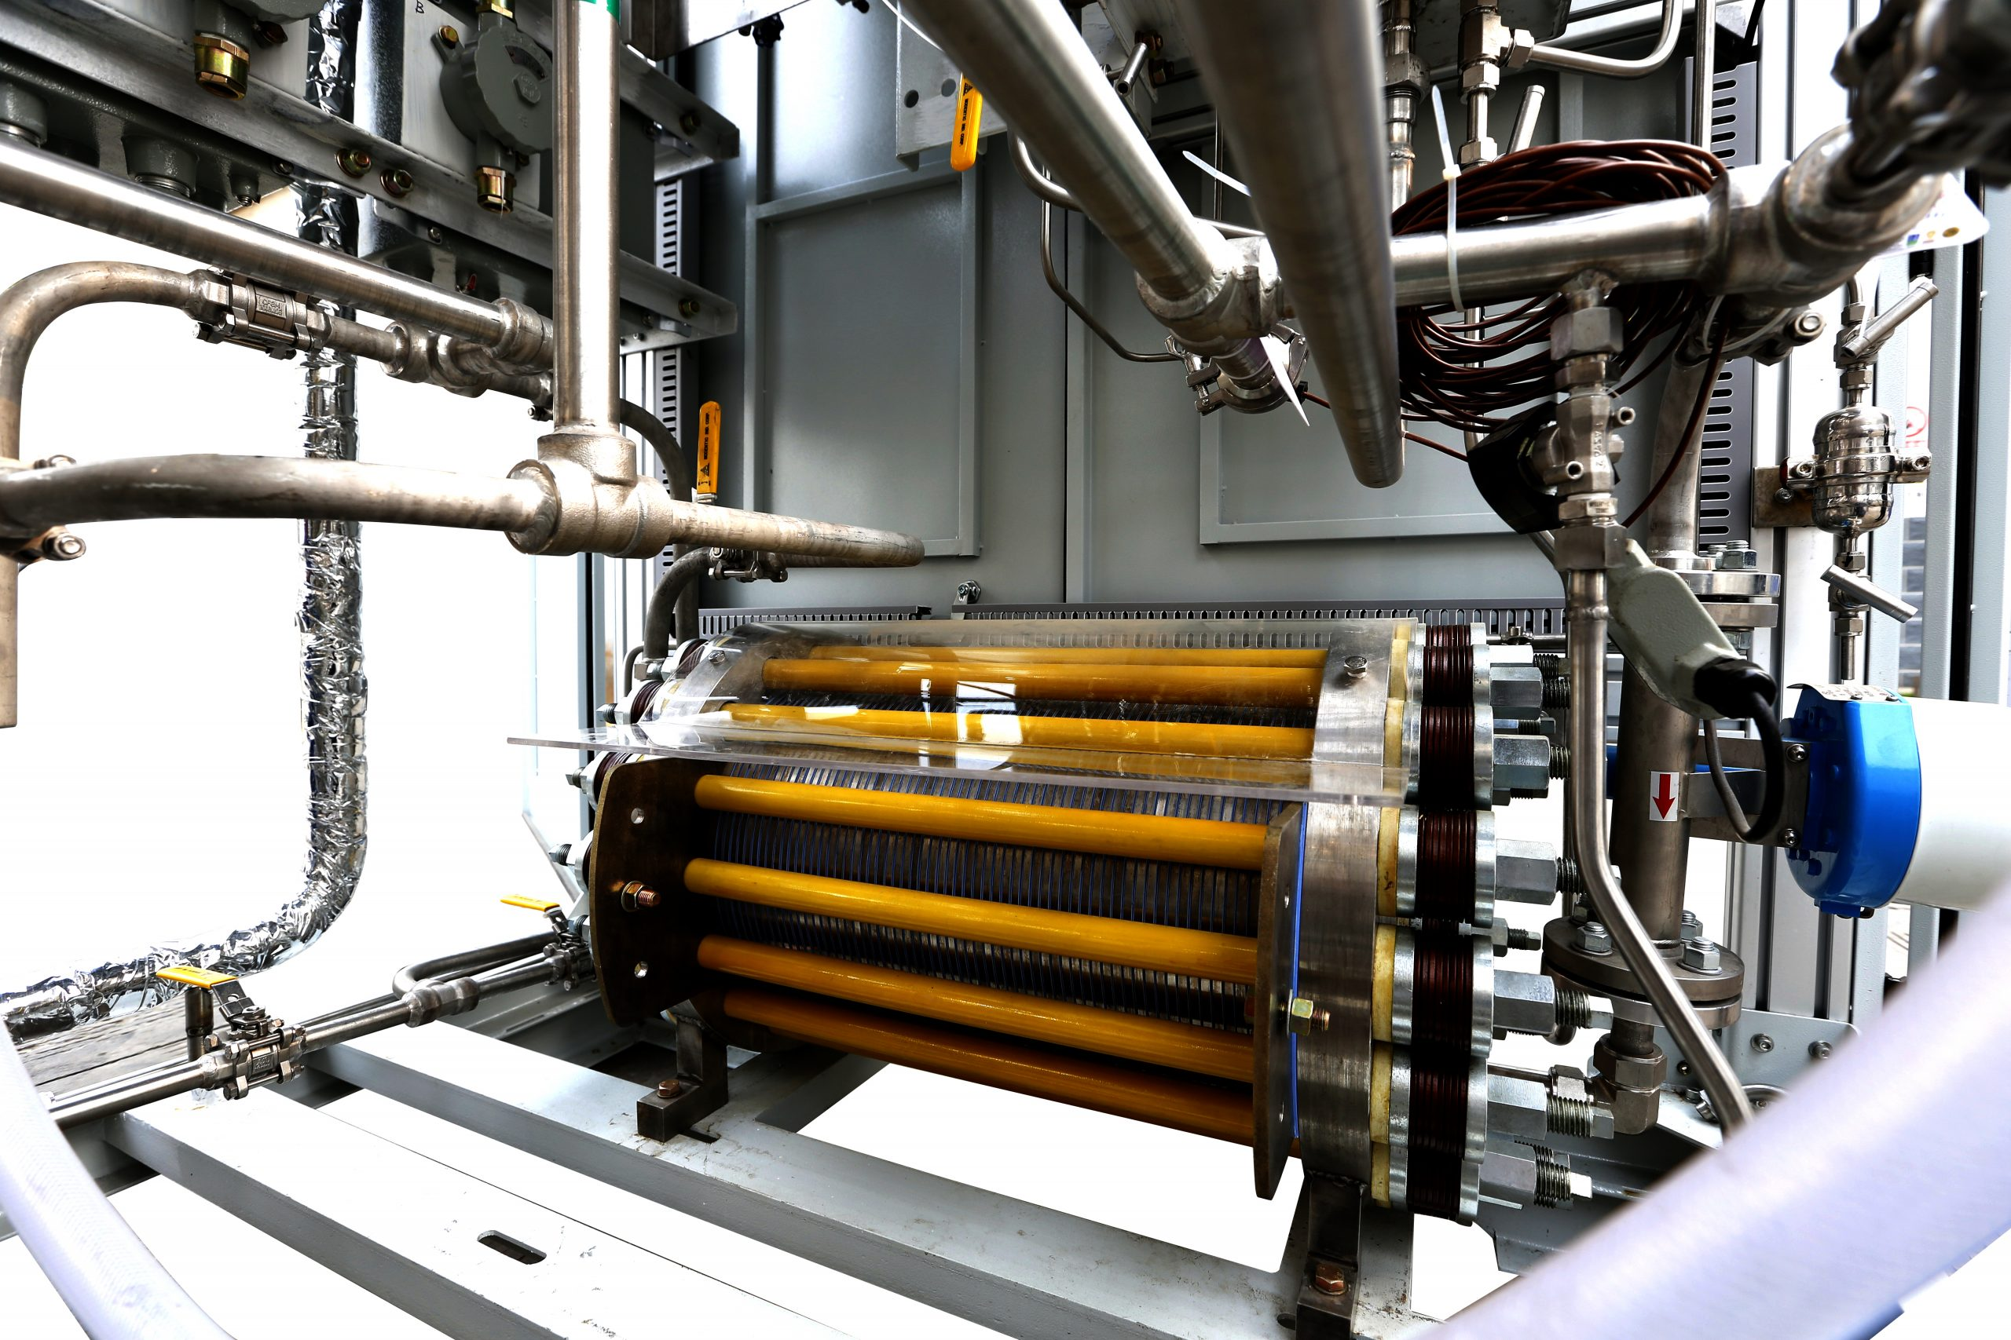
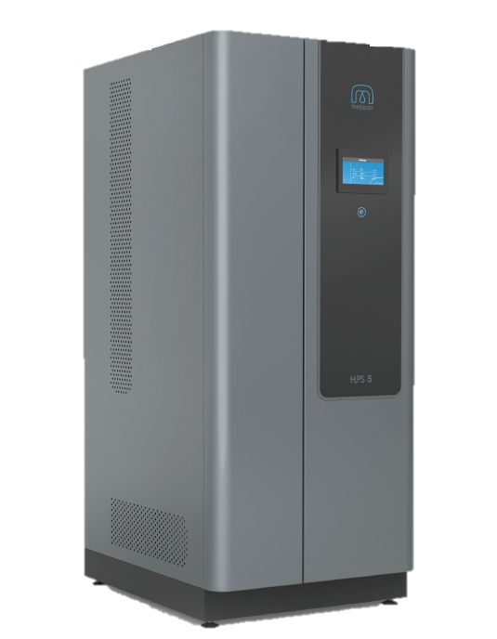
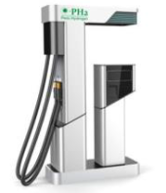


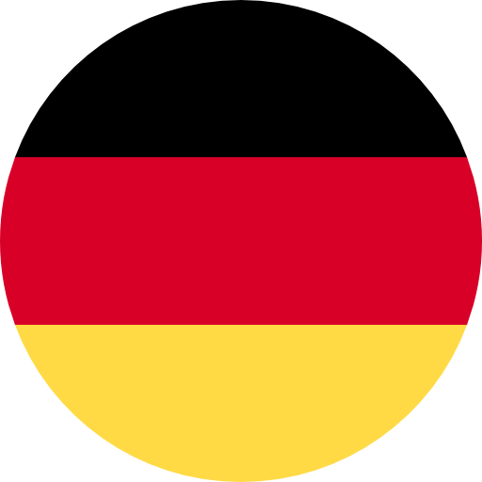


Metacon – building a complete fossil-free hydrogen portfolio
BUSINESS OVERVIEW
Products and solutions in fossil-free “green” hydrogen
Hydrogen production technologies
Complementary technologies
International presence
Hydrogen Reformers
Patents
6 International and European
Uppsala, Sweden
Sales, marketing and central functions
Know-how
Metacon HQ
Deep experience in the biogas market
Metacon GmbH
Düsseldorf, Germany
Sales and marketing
Market access
Access to biogas and wastewater treatment plants thanks to scale
Reformers
Electrolysers
Combined Heat and Power Units
Hydrogen Refuelling Stations
Patents
6 International and European
Patras, Greece
Wholly owned subsidiary
R&D and manufacturing
Metacon S.A
Scale
Yokohama, Japan
Sales and marketing
Wide range of applications and users
6 International and European patents
6 International and European patents
Integrated or stand alone HRS
Metacon KK
Short Lead times
Market leadership
Leader in small commercial applications
Deep experience of and access to the biogas market
Proven and Largest stack sizes on the market (10 MW)
Wide range of applications and users
Capacity from 5 -3,500 kg per day¹
Lead time
Compact size adapted to biogas and wastewater treatment plants
High manufacturing capacity and leading cost efficiency
Small commercial applications
Storage of up to 5,000 kg and pressures over 1,000 bar²
8 months vs. 18 months by competitors
Scale
Largest stack sizes on the market (10 MW)
Cost leadership
Leading manufacturing capacity results in cost efficiency
Source: Company information
Note: 1) Integrated HRS holds a capacity of 10-3,500 kg per day and independent HRS 5-3,500 kg per day; 2) With regards to hydrogen storage and hydrogen transportation/distribution

Slide 5
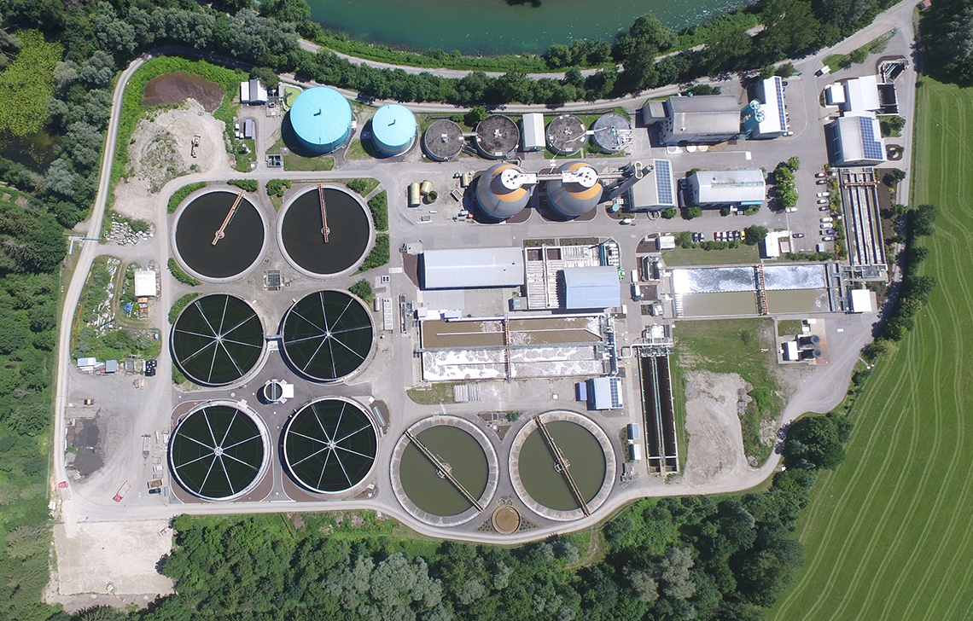
The biogas market can transition into green hydrogen – off grid…
GREEN HYDROGEN MARKET
Metacon showcasing reforming technology in Germany 2024
Overview AVKE project
German market
Outcome and potential
Announced in November 2022 a MoU with AVKE for local, off-grid hydrogen production from biogas using wastewater as methane source
Mid-sized HHG hydrogen generator placed on site at AVKE in Kempten, Germany
24/7 continuous operation integrated into a professional wastewater treatment plant
Demonstration plant for Metacon in Germany and beyond
Regulatory approval process ongoing
> 10,000 biogas and wastewater treatment plants
Average plant capacity over 100 Nm3 biomethane per hour
Highest biogas production density in Europe
1
One of the most carbon-negative and climate cooling technologies known
2
Bi-products in terms of non-fossil green CO2 can be used as industrial raw material
3
Up to 600 kg pure hydrogen produced daily
(AVKE 1st generation 110 kg/d)
AVKE site in Kempten, Germany
4
99.999% hydrogen quality
Grid-independent and local green hydrogen production in one of the key markets in Europe
Source: Company information.

Slide 6

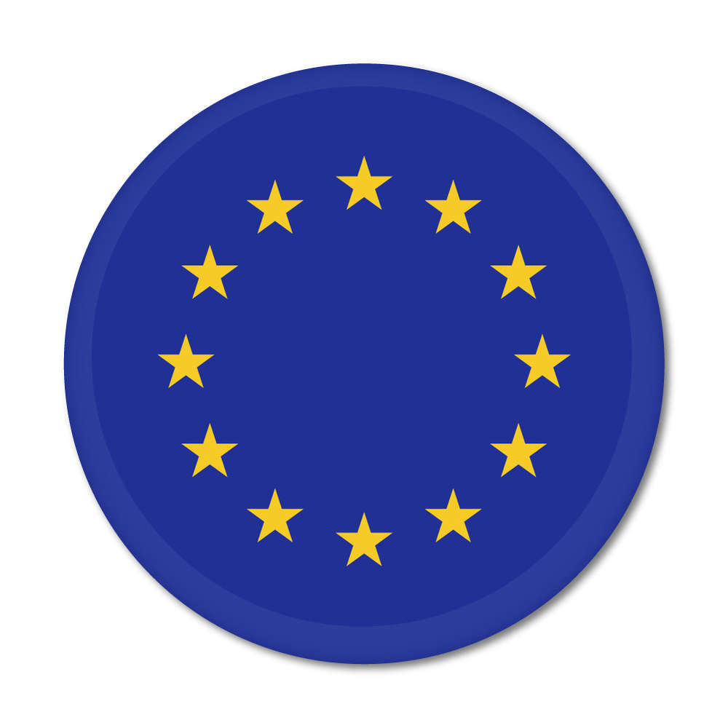
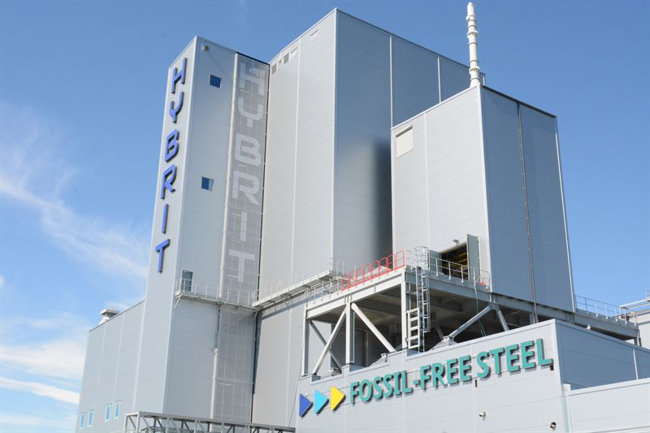
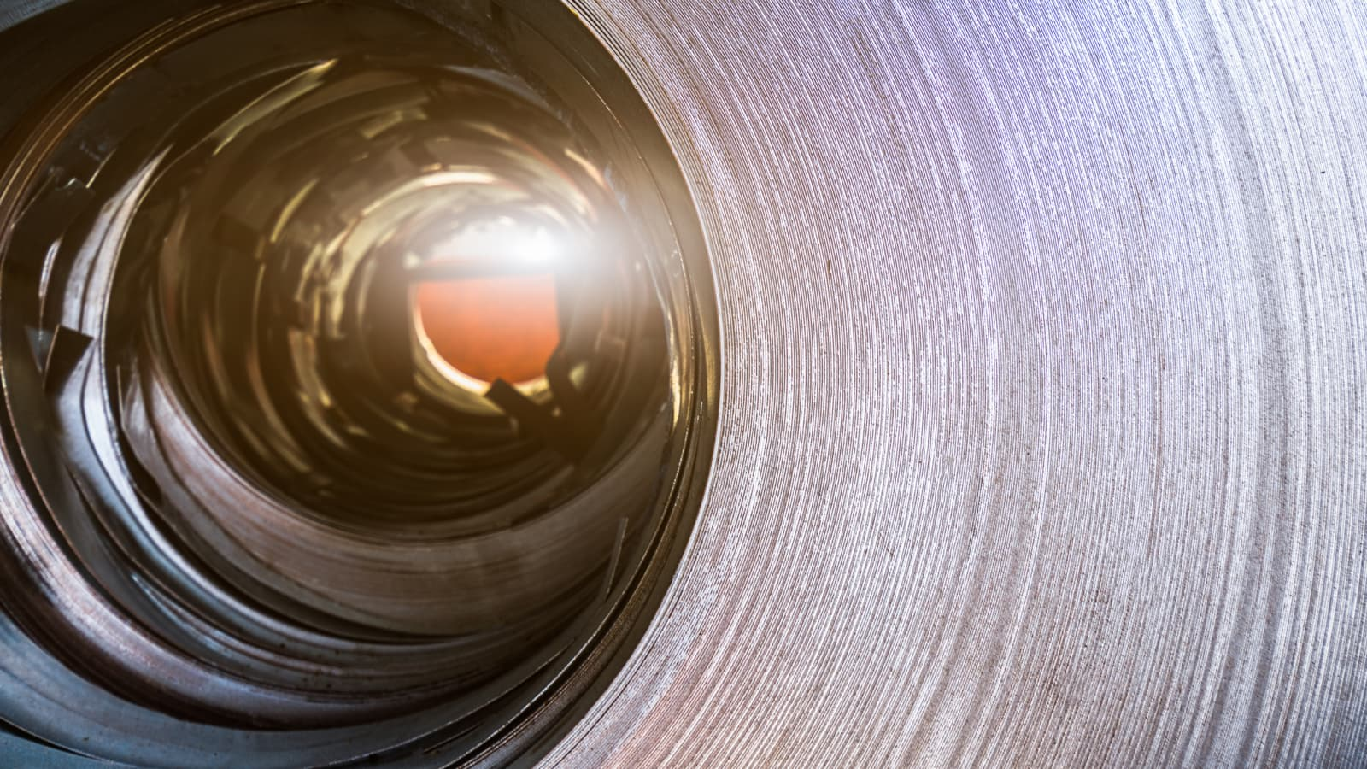
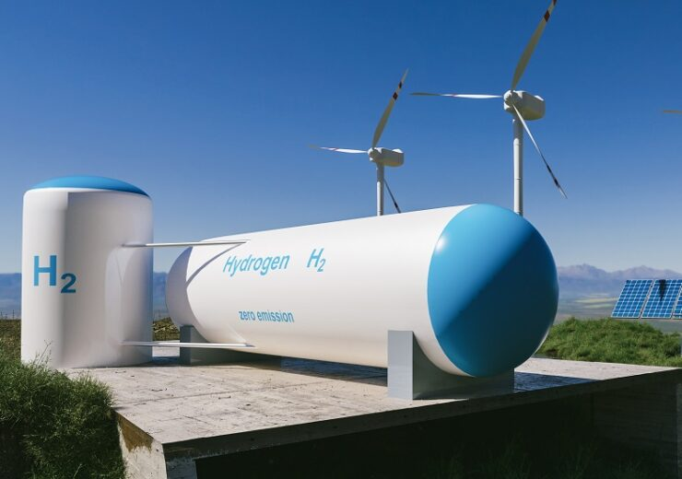
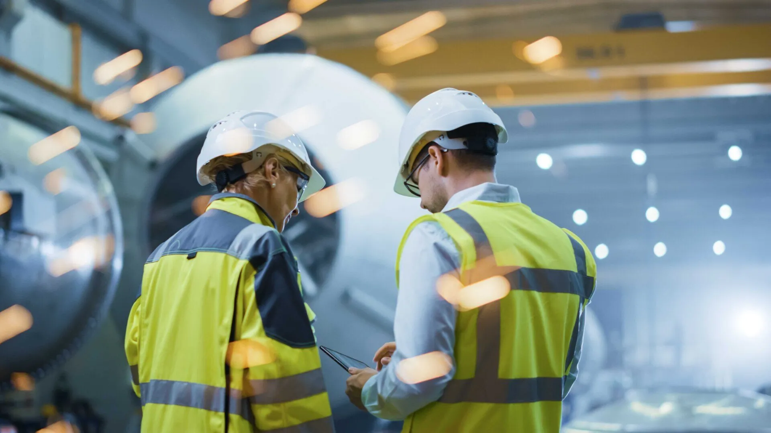
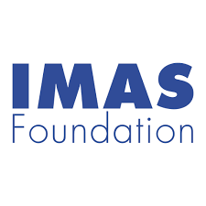
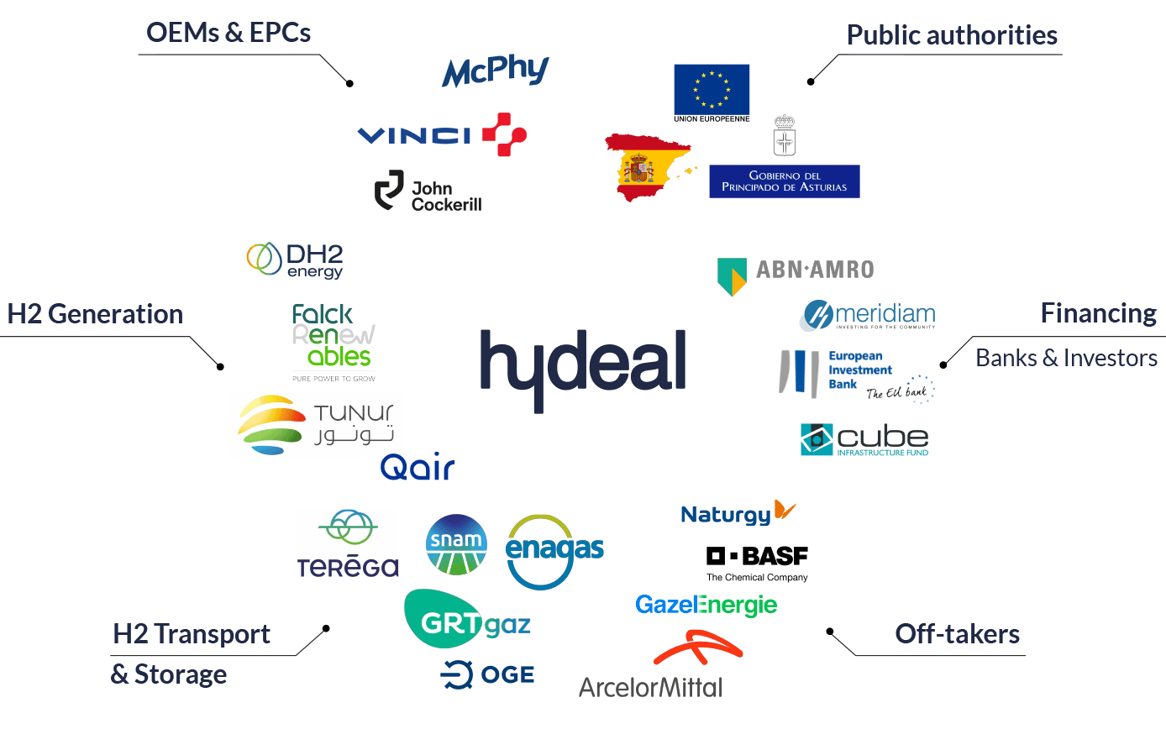

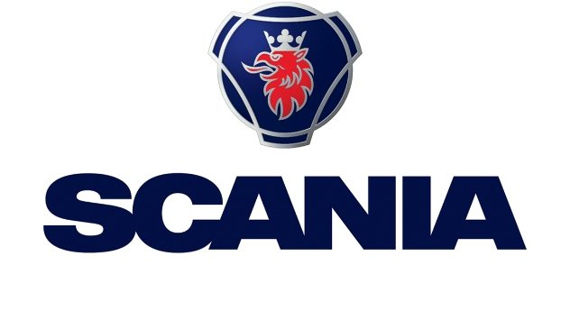
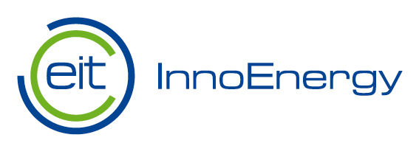

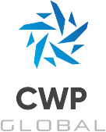




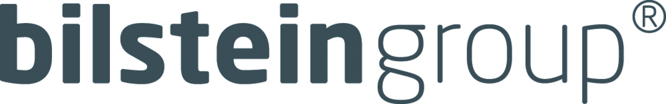

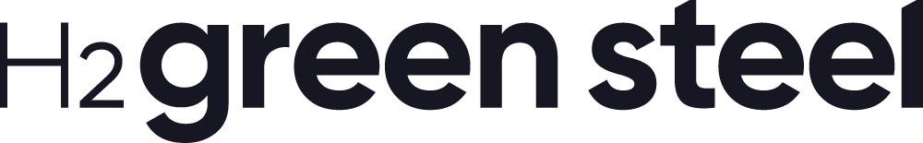

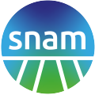

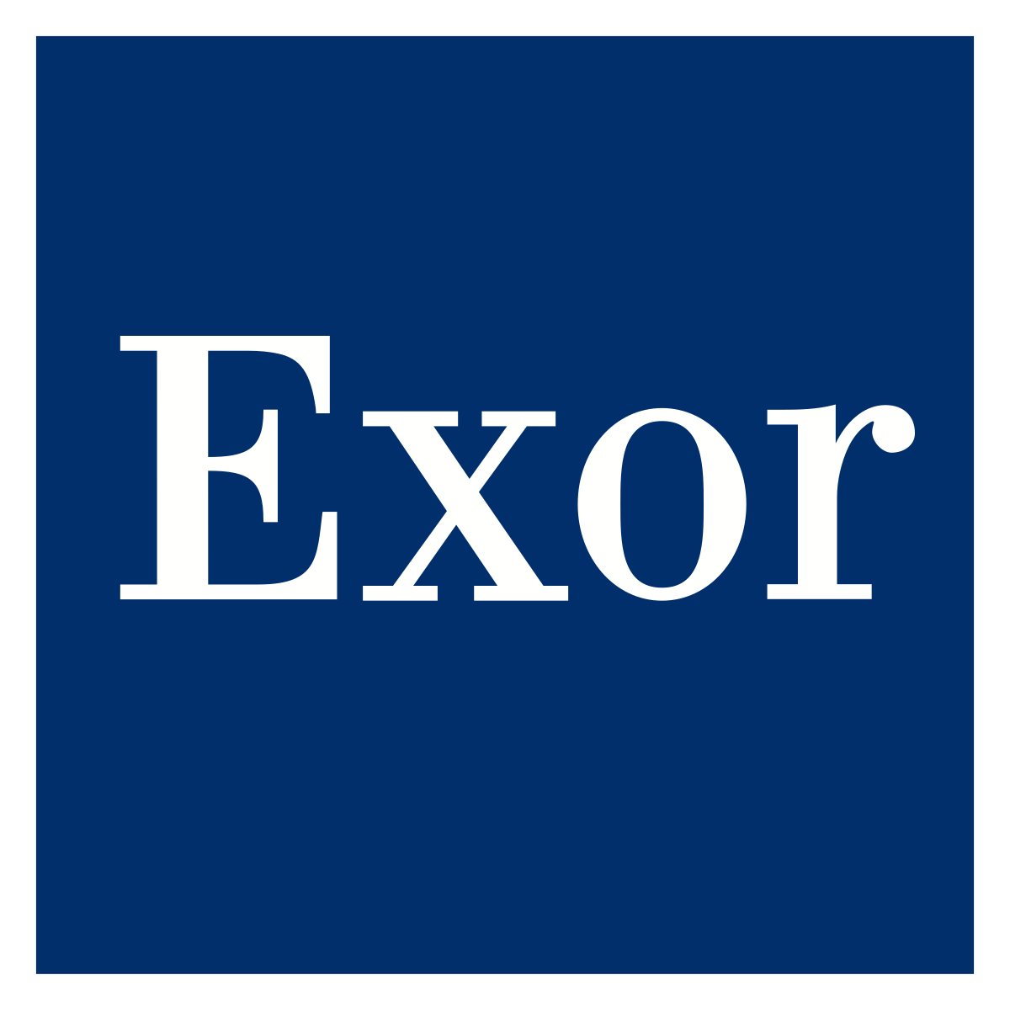
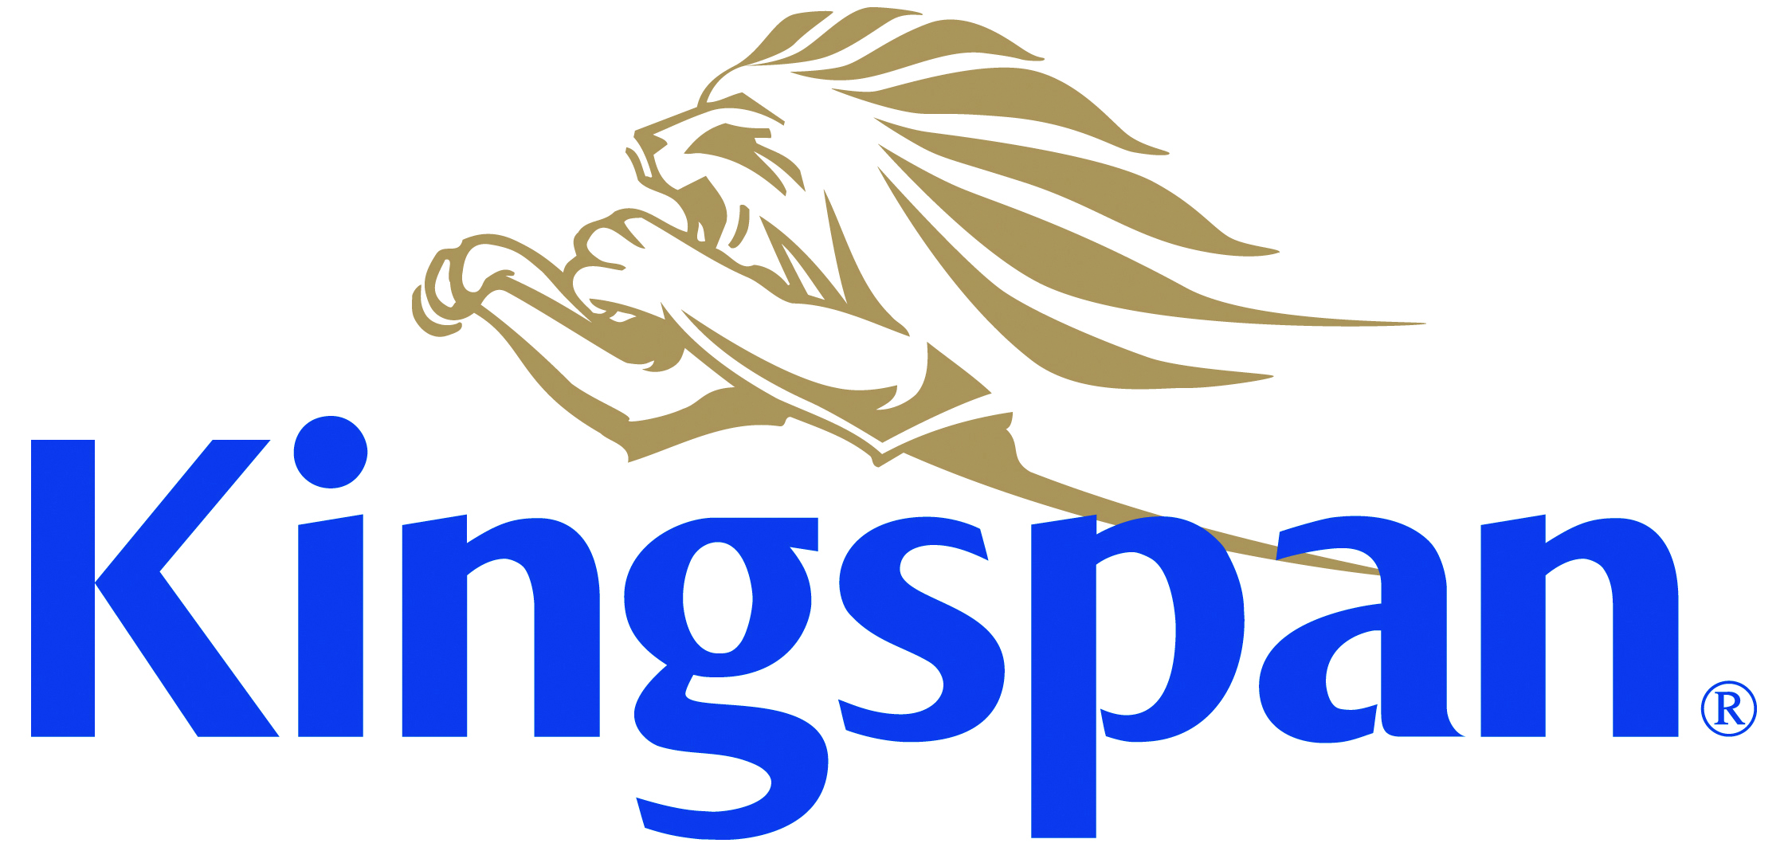
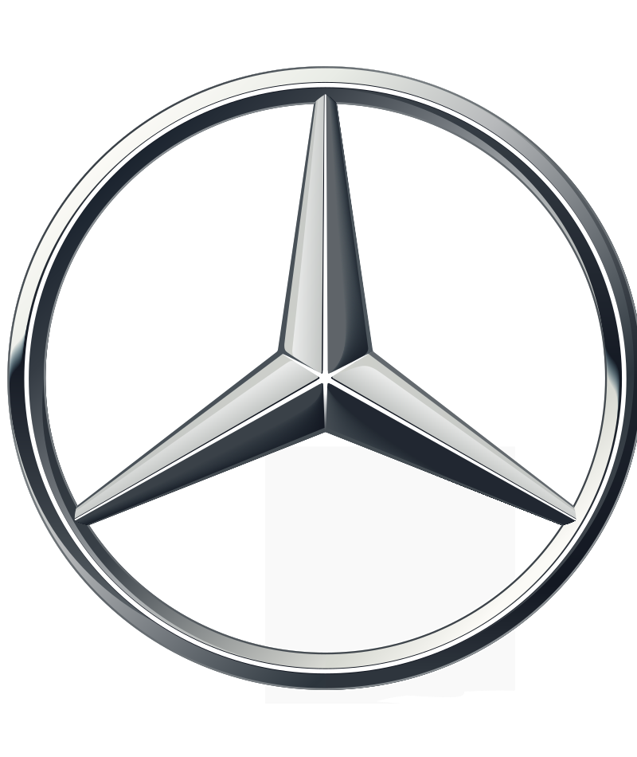




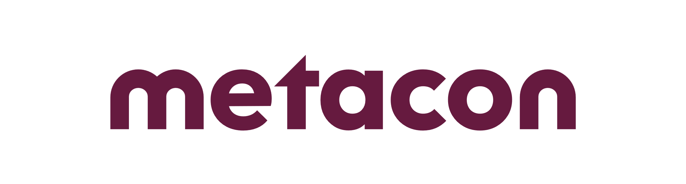
GREEN HYDROGEN MARKET
Base industry green hydrogen projects will need massive amounts of electrolysers
New projects in Sweden and Europe evidencing Hydrogen market momentum
HYBRIT: fossil-free steel
H2Green Steel
The Green Hydrogen Catapult
HyDeal Ambition
>1 GW
Electrolysis capacity needed short-term
>1 GW
Electrolysis capacity needed short-term
80 GW
Electrolysis capacity by 2030, 45 GW already committed
67 GW
Electrolysis capacity by 2030
Decarbonising the Swedish steel industry by replacing the coking with hydrogen
Investing in hydrogen plant allowing for production of green steel with a 95% reduction in CO2 emissions
Joining forces to fiftyfold scale-up of global hydrogen production capacity
Cross-industry platform building the infrastructure and value chain required for Europe to transition.
Global industry giants, financiers and governments coming together for the green energy transition using green hydrogen
Source: Hybrit, H2 Green Steel, Green Hydrogen Catapult, HyDeal Ambition.
6
6

Slide 7
Huge demand for large-scale industrial electrolysis systems is expected. We see a need and an opportunity for electrolyser manufacturing in Sweden.

Slide 8
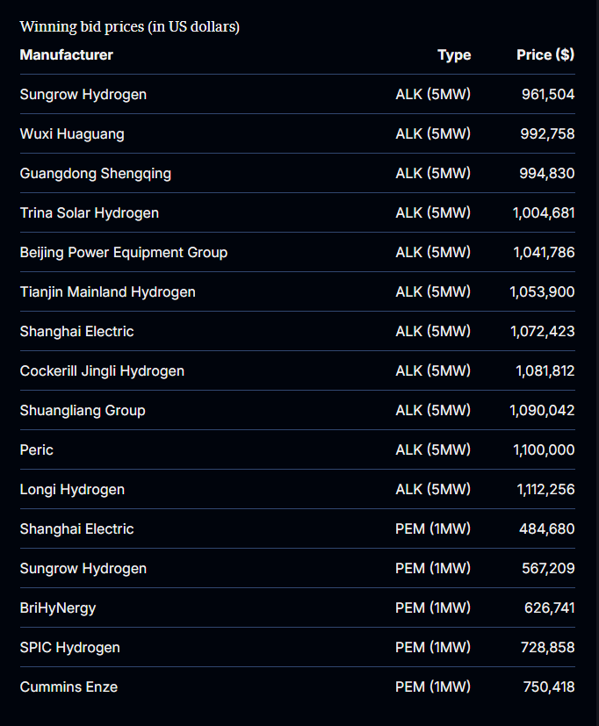
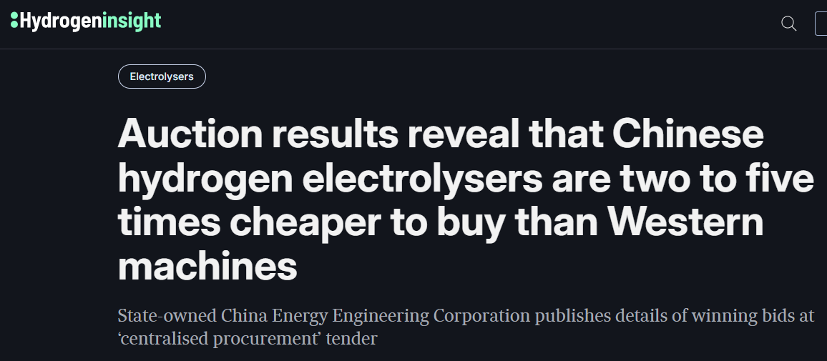
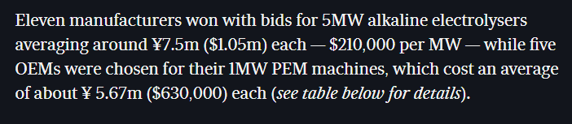
Chinese electrolysers are currently sold at around four times lower price than “Western”…
GREEN HYDROGEN MARKET
Competition is coming…
Affordable green hydrogen can be produced.
Important hydrogen based projects can be enabled.

Slide 9
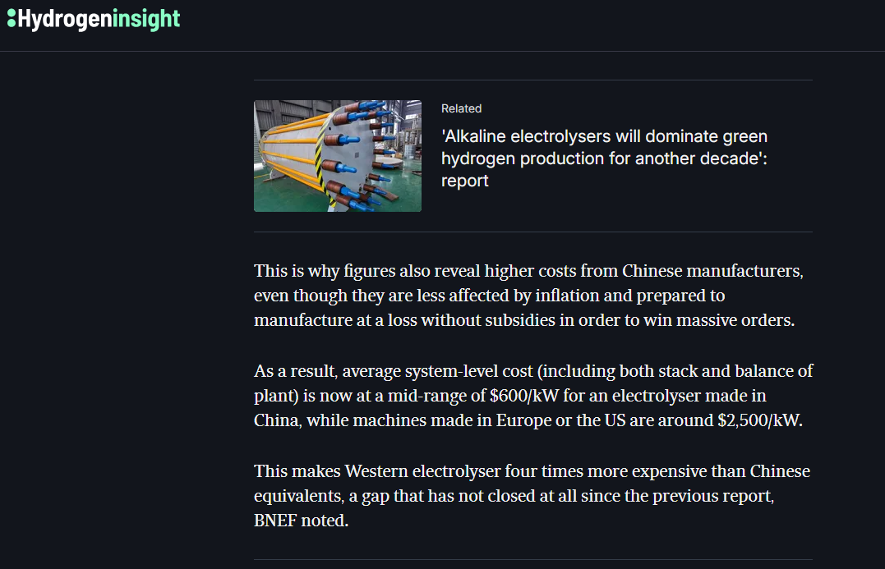
Chinese electrolysers are currently sold at around four times lower price than “Western”…
GREEN HYDROGEN MARKET

Slide 10
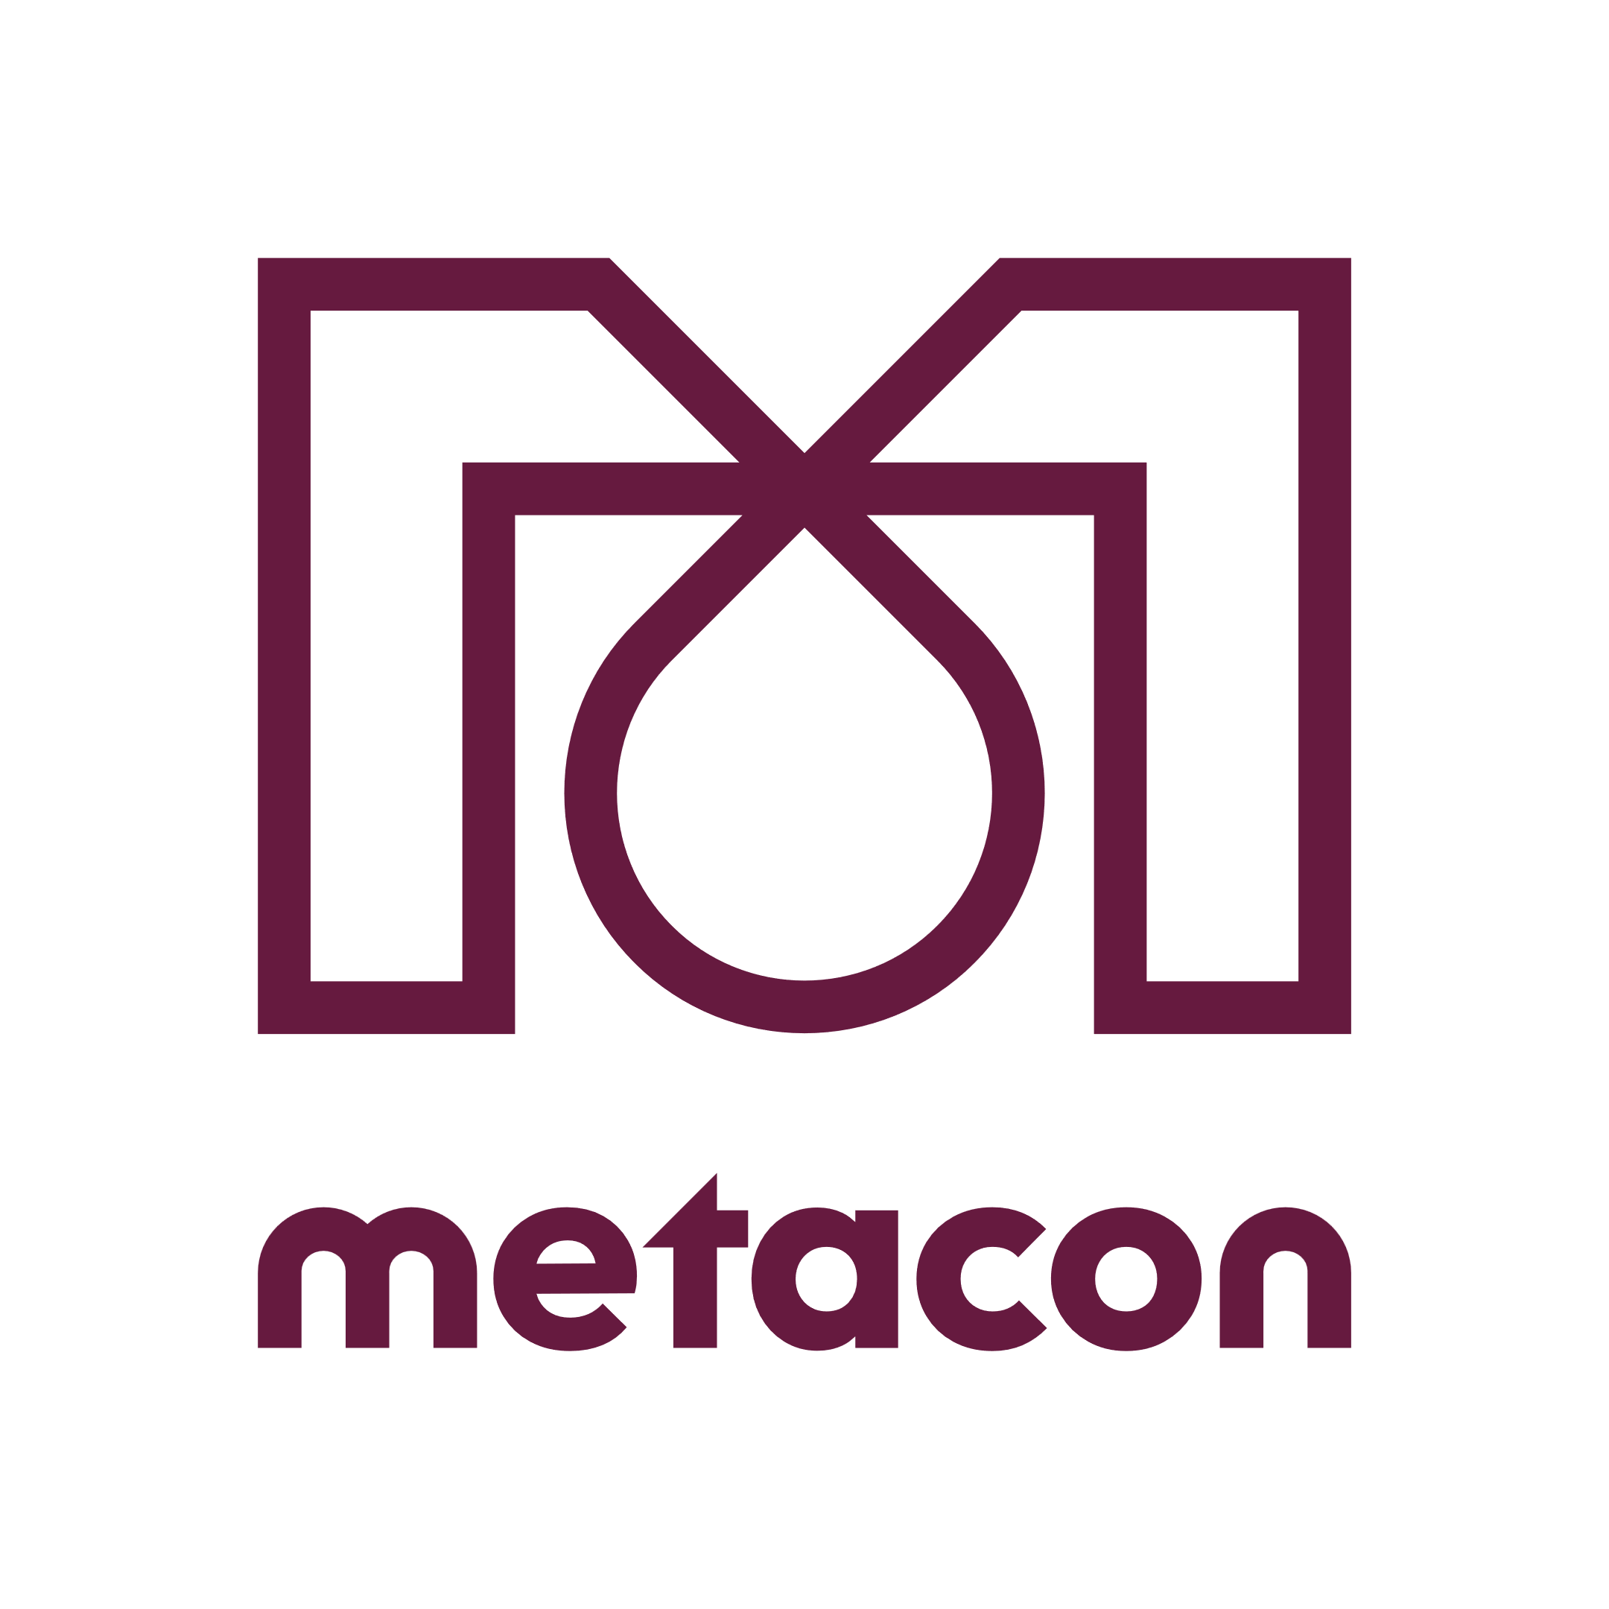

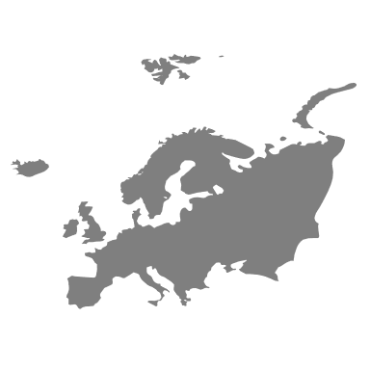



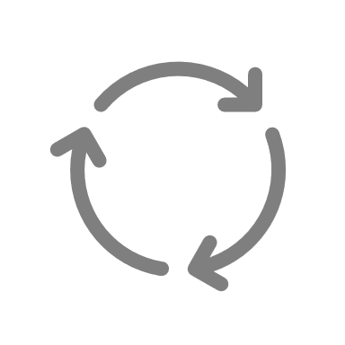


Metacon and PERIC teamed up in 2020
Sales Europe
System and balance of plant delivery
Installation and commissioning
After-Sales services
World leading Electrolyser technology and manufacturing
System design, providing solutions to complex customer requirements
Hydrogen system experience based on over 1,000 installed system integrations worldwide

Slide 11
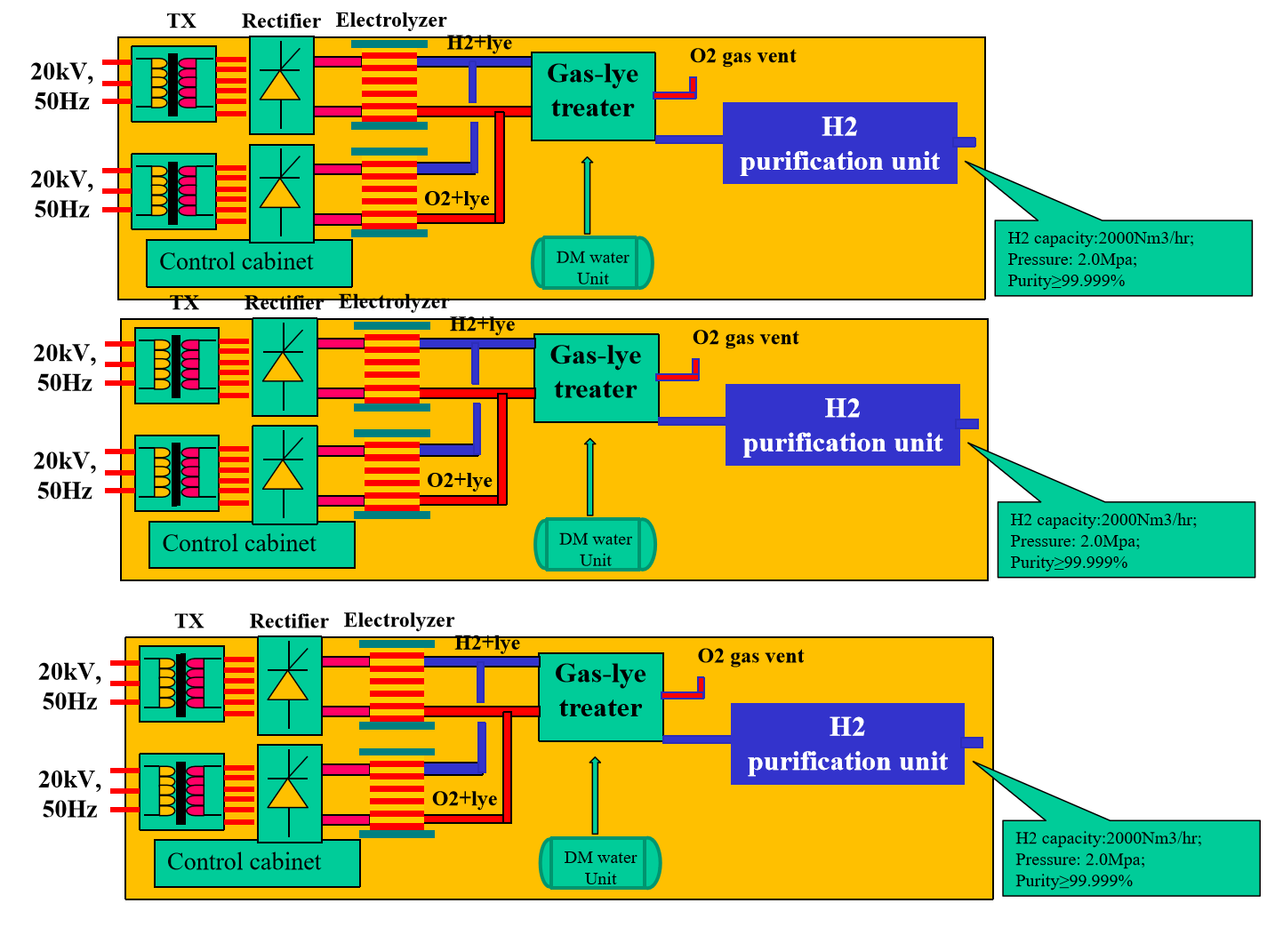
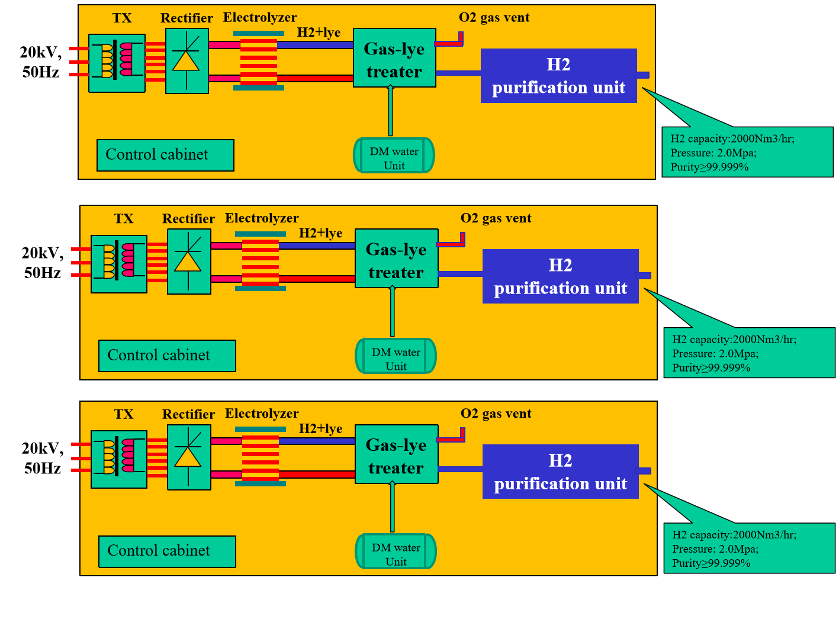
PERIC has super-strong large-scale technology (design concept example 30 MW plant)
DESIGN CONCEPTS FOR INDUSTRIAL AEL PLANTS
5 MW AEL + BoP
10 MW AEL + BoP
4.85 kWh AC per Nm3 (including BoS), > 50 stacks in operation In operation since 2014 Degradation < 0.4-0.8 % per year (8 400 h/yr) real time data
5.00 kWh AC/Nm3 (including BoS)
New 2023, one unit under commissioning, 16 % less CAPEX 5 MW
Degradation < 0.8 % calculated (8 400 h/yr)
Source: Company information.

Slide 12

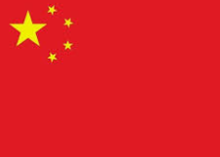
Reinventing how to work with China
EU market
CN market
Technology exchange…
Source: Company information.
12

Slide 13
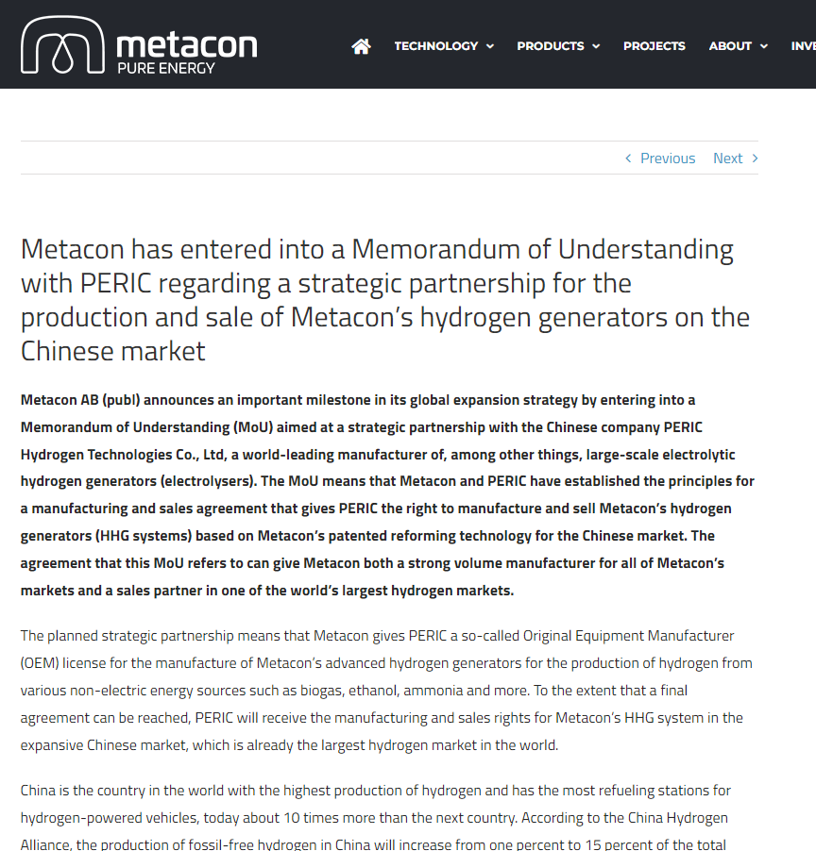
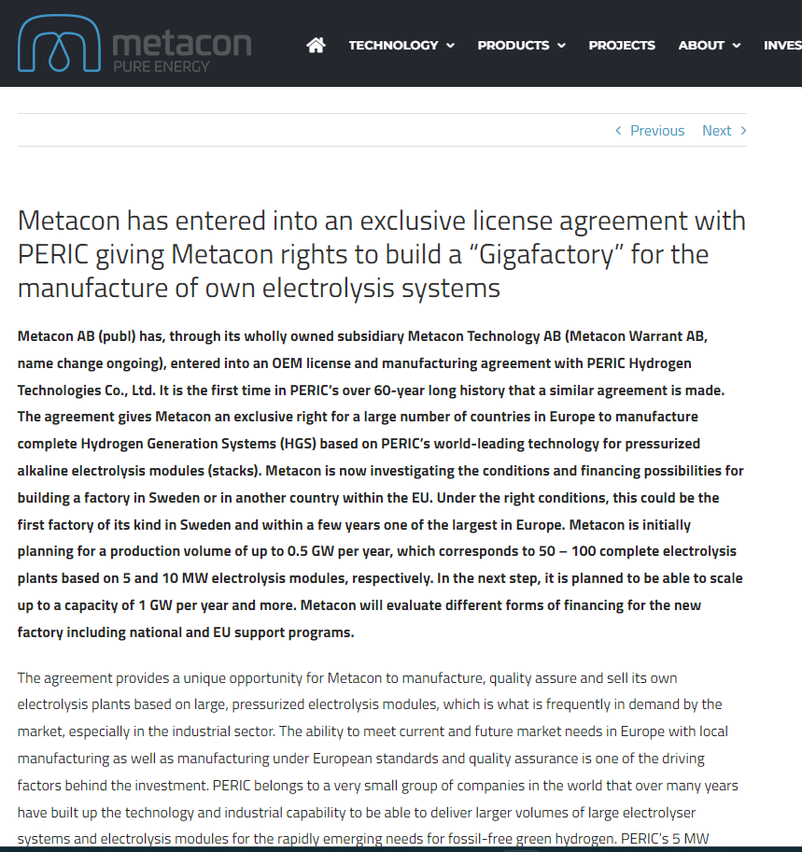
Reinventing how to work with China
Source: Company information.
13

Slide 14
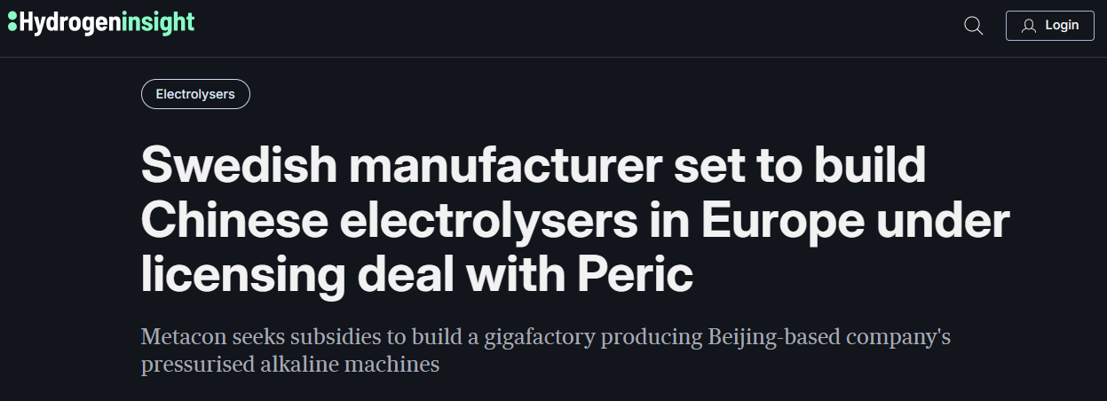
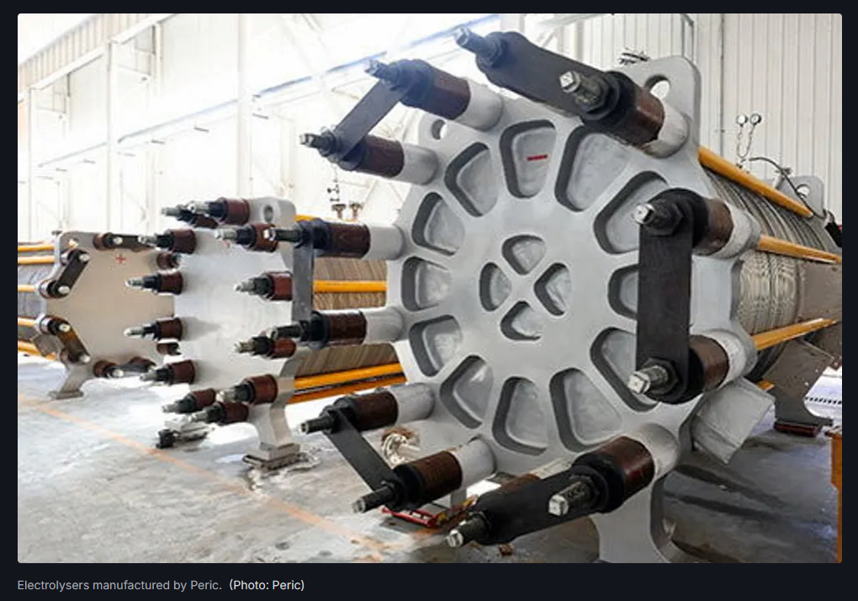
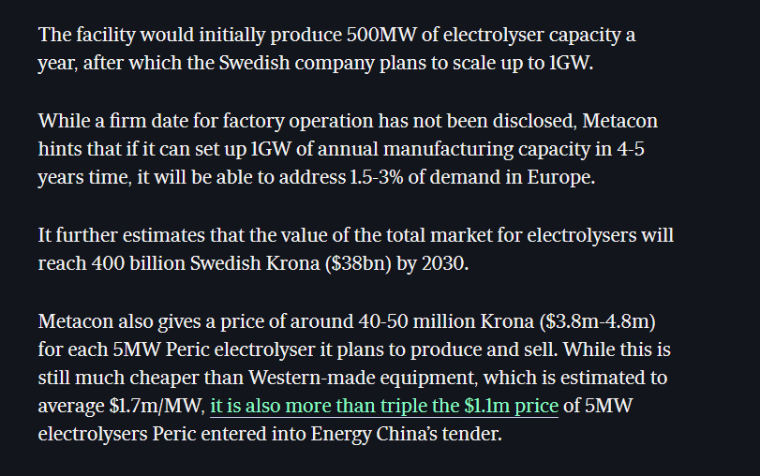
Giga-scale manufacturing of electrolysers based on PERIC license and partnership
Source: Company information.
14

Slide 15
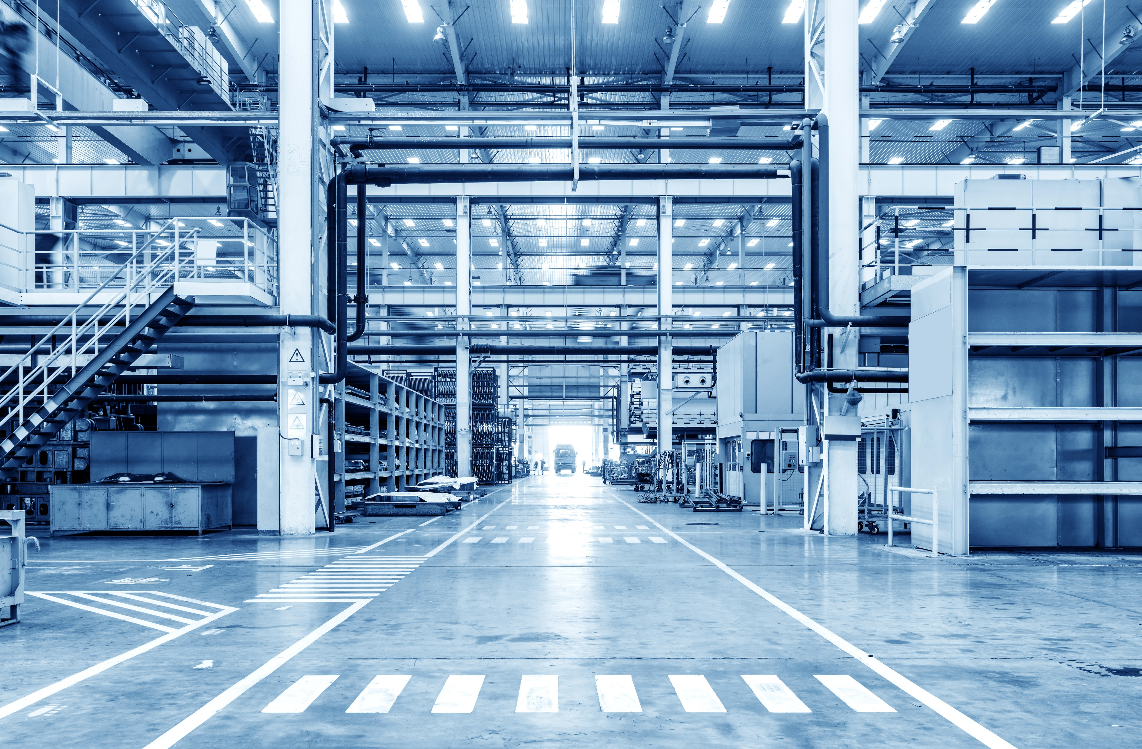
INTRODUCTION TO METACON
The
Metacon in breif
Electrolyser gigafactory project
Source: Company information.
15
15

Slide 16
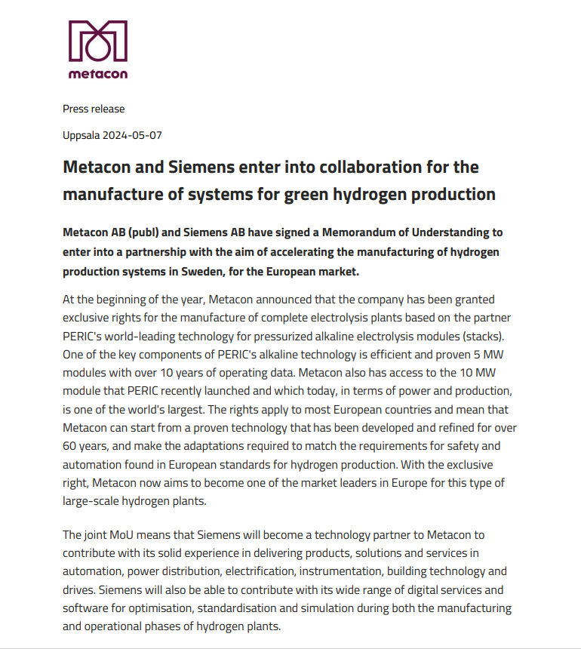
Technology partnership with Siemens
Source: Company information.
16

Slide 17
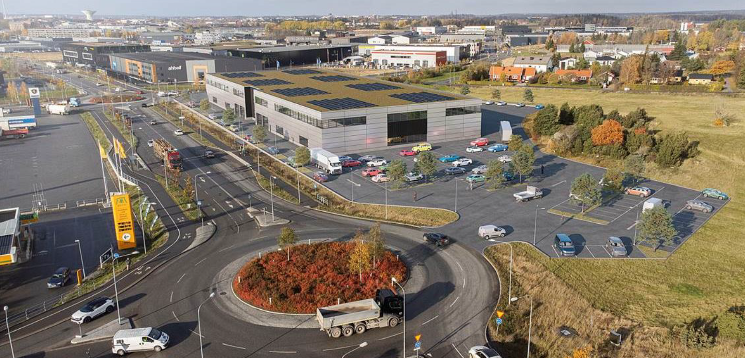
Example of potential alternative for factory location in Uppsala
Source: Croisette Real Estate Partner.
17

Slide 18
Avslutningsvis…
Hur möter vi kommande förväntade behov av elektrolysanläggningar och fossilfri vätgas?
Vilka är nycklarna för att få i gång den fossilfria vätgasmarknaden?
En industriell möjlighet för Sverige?
Source: Company information.

Slide 19
THANK YOU!

