Slide 1

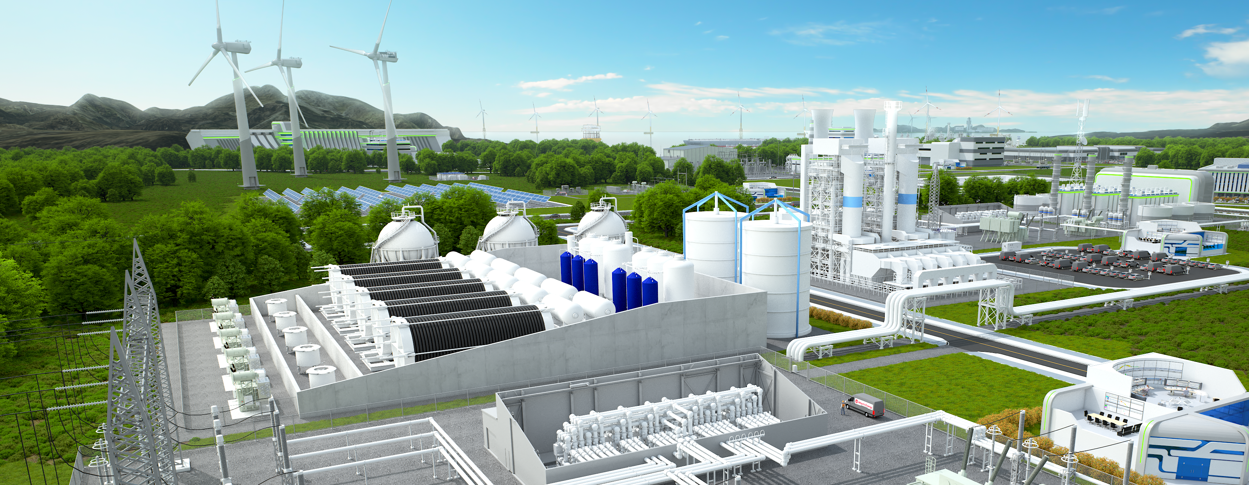




Hydrogen Solutions
Martin Frödin
2023-03-09
Notes:
Vad är egentligen Hitachi Energy´s roll när det kommer till vätgas?
Hur ansluter man grön vätgas till elnätet?
Hur säkerställer vi god elkvalté för vätgasapplikationer?
Alt: Elkvalité, ska det vara nödvändigt?
HyFlex vätgasgenerator. Ett minne blott med dieselgeneratorer?

Slide 2

Why hydrogen?
Green hydrogen is produced with renewable electricity
…and will play a key role in decarbonizing hard-to-abate industries.

Slide 3

Reaching carbon neutrality
Green hydrogen is produced by splitting water with renewable electricity
2050
520 million tons of low-emission hydrogen annually
2024
…to reach carbon neutrality by 2050.
…and can play a key role in decarbonizing hard-to-abate industries

Slide 4

Hitachi Energy supports your hydrogen journey
Green hydrogen is produced by splitting water with renewable electricity
Hur ansluter man grön vätgas till elnätet?
Hur säkerställer vi god elkvalitet för vätgasapplikationer?
HyFlex vätgasgenerator – Ett minne blott med dieselgeneratorer?
…and can play a key role in decarbonizing hard-to-abate industries

Slide 5


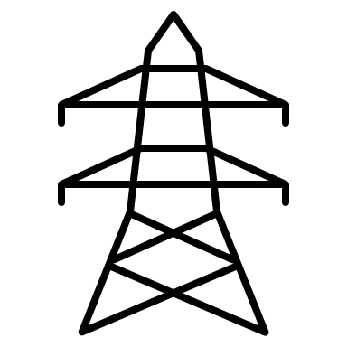
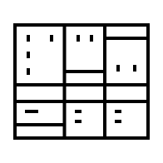
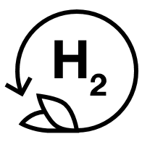
Power-to-Gas
Renewable Generation
Hydrogen Production
Safe
Reliable
Compliant
New types of energy sources:
Fewer rotating machines
High variability
Low predictability
New types of electrolyzer loads:
Concentrated
large-scale
Variable power supply
Understanding both sides is paramount to enable overall system optimization
Notes:
Both generation and load side of the power grid are changing
Understanding both sides and how to connect them is paramount to enable overall system optimization
Aging electrolyzis

Slide 6
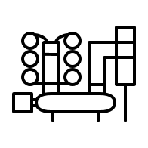
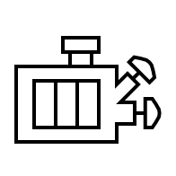
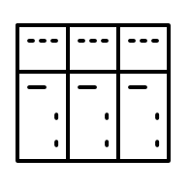

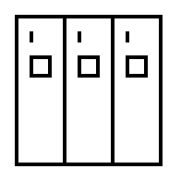

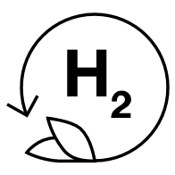
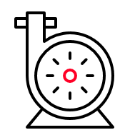
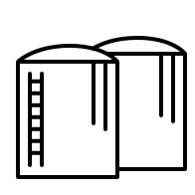

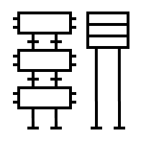


Power-to-Gas
The Hitachi Energy Way – From Grid-to-Stack
HV grid connection
Power transformers
Rectifier transformers
AC/DC
rectifier
MV
Electrolyzer
Hydrogen
Compression
Storage
Studies
Power Quality
SCADA / EMS
Service
Hitachi Energy
End-User
Earning your trust
from early studies…
          through project realization….
          to long-term service

Slide 7
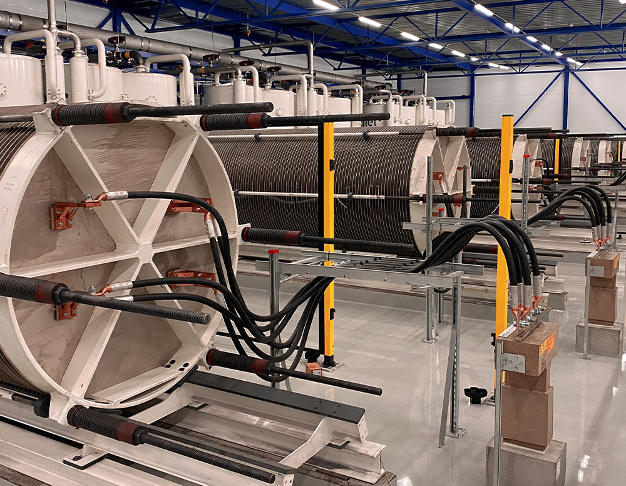
Power-to-Gas – Ovako, Sweden
Consortium lead by Ovako with Volvo, Nel, H2GS and Hitachi Energy
20MW alkaline electrolysis solution
replaced natural gas with green hydrogen
now offering green steel at a premium price!
Notes:
Studies as guidance towards best AC/DC rectification solution enabling grid code compliance
Containerized power supply system including rectifiers, dry rectifier transformers
Water cooling of dry transformer enabling re-use of dissipated heat

Slide 8
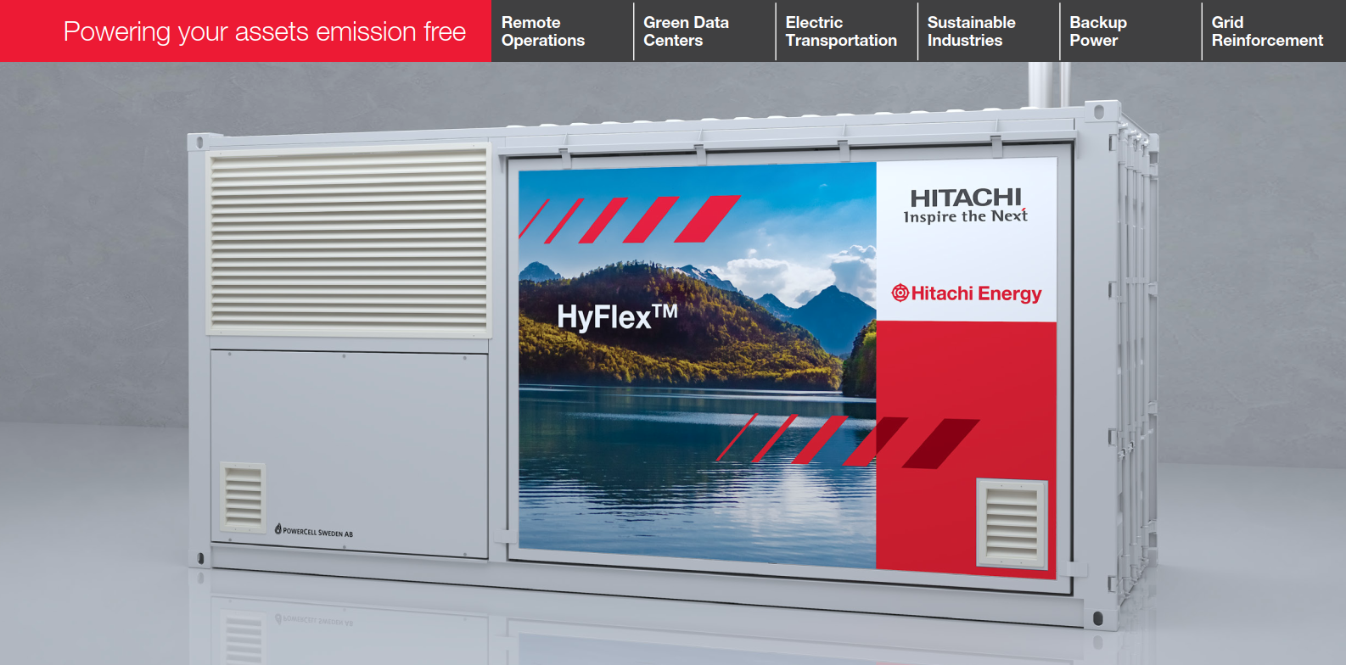
Gas-to-Power
Based on zero emission fuel cell technology
Electrify your assets, decarbonize your operations
Advance a sustainable energy future for all!
HyFlexTM hydrogen power generator
From 400 kVA to 1 MVA+
Notes:
From 400 kVA to 1 MVA+

Slide 9
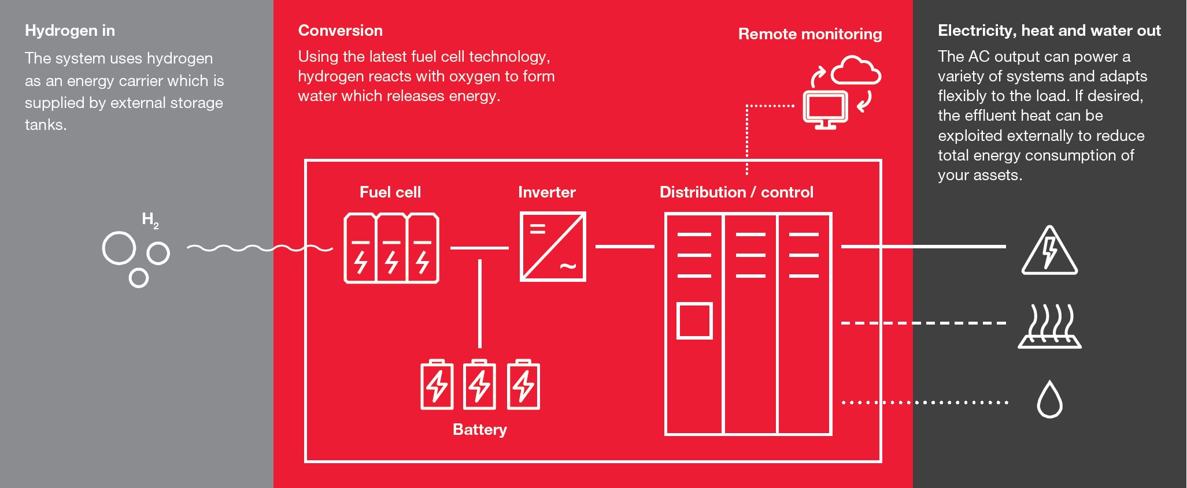
How it works

Slide 10
HyFlex applications
Backup
< 10% utilization
Data Centers
Substations
Emergency infrastructure
Critical industries
Clean backup power for durations beyond the capacity of batteries
Intermediate
~ 50% utilization
Construction / mining
Temporary Power
Remote events
Wayside charging
Deployable, distributed and flexible green power generation
Continuous
> 90% utilization
Data Centers
Logistic hubs
Surplus hydrogen operations
Off-grid communities
Large operations dependent on fossil fuel-based power generators

Slide 11
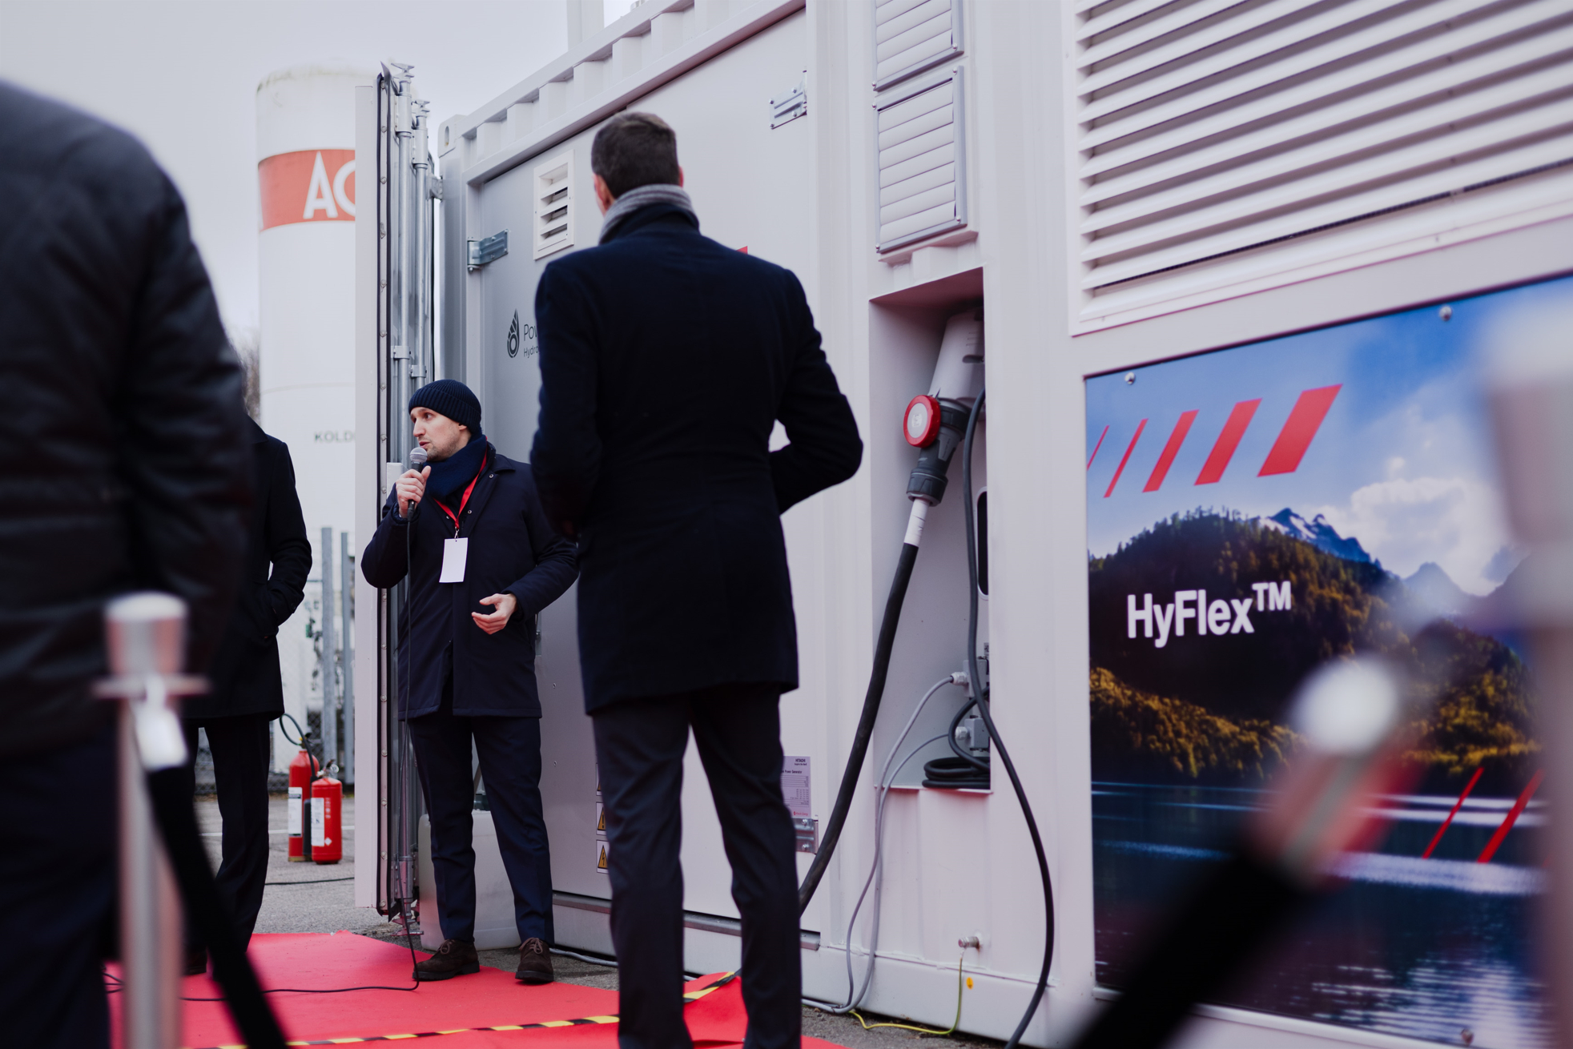
HyFlex inauguration event
Over 100 guests attended the ceremony in November 2023
Unveiling of the first HyFlex Demonstration Unit
Fully functional, scaled down variant of the series product
Event facility powered by HyFlex running on hydrogen

Slide 12
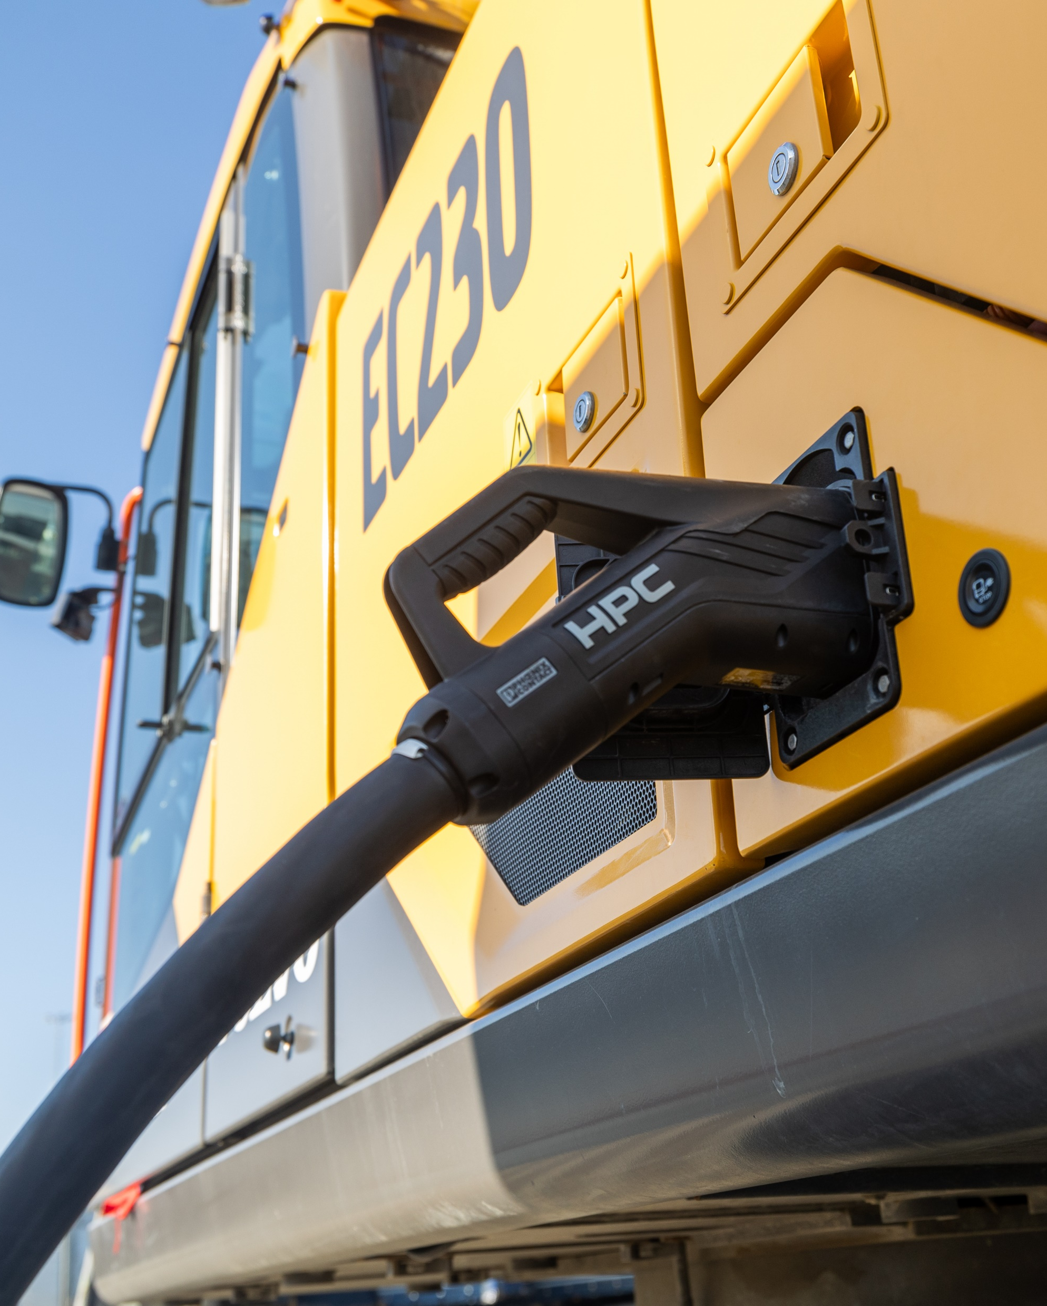
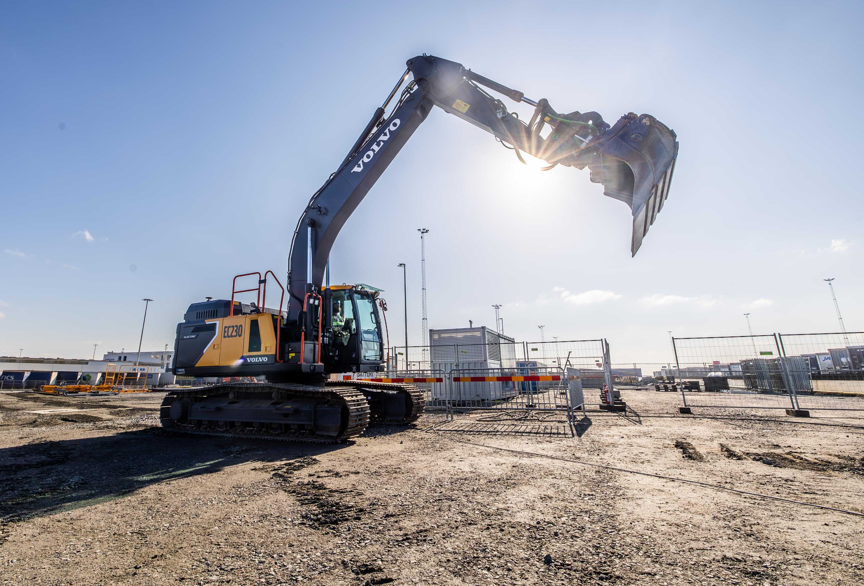
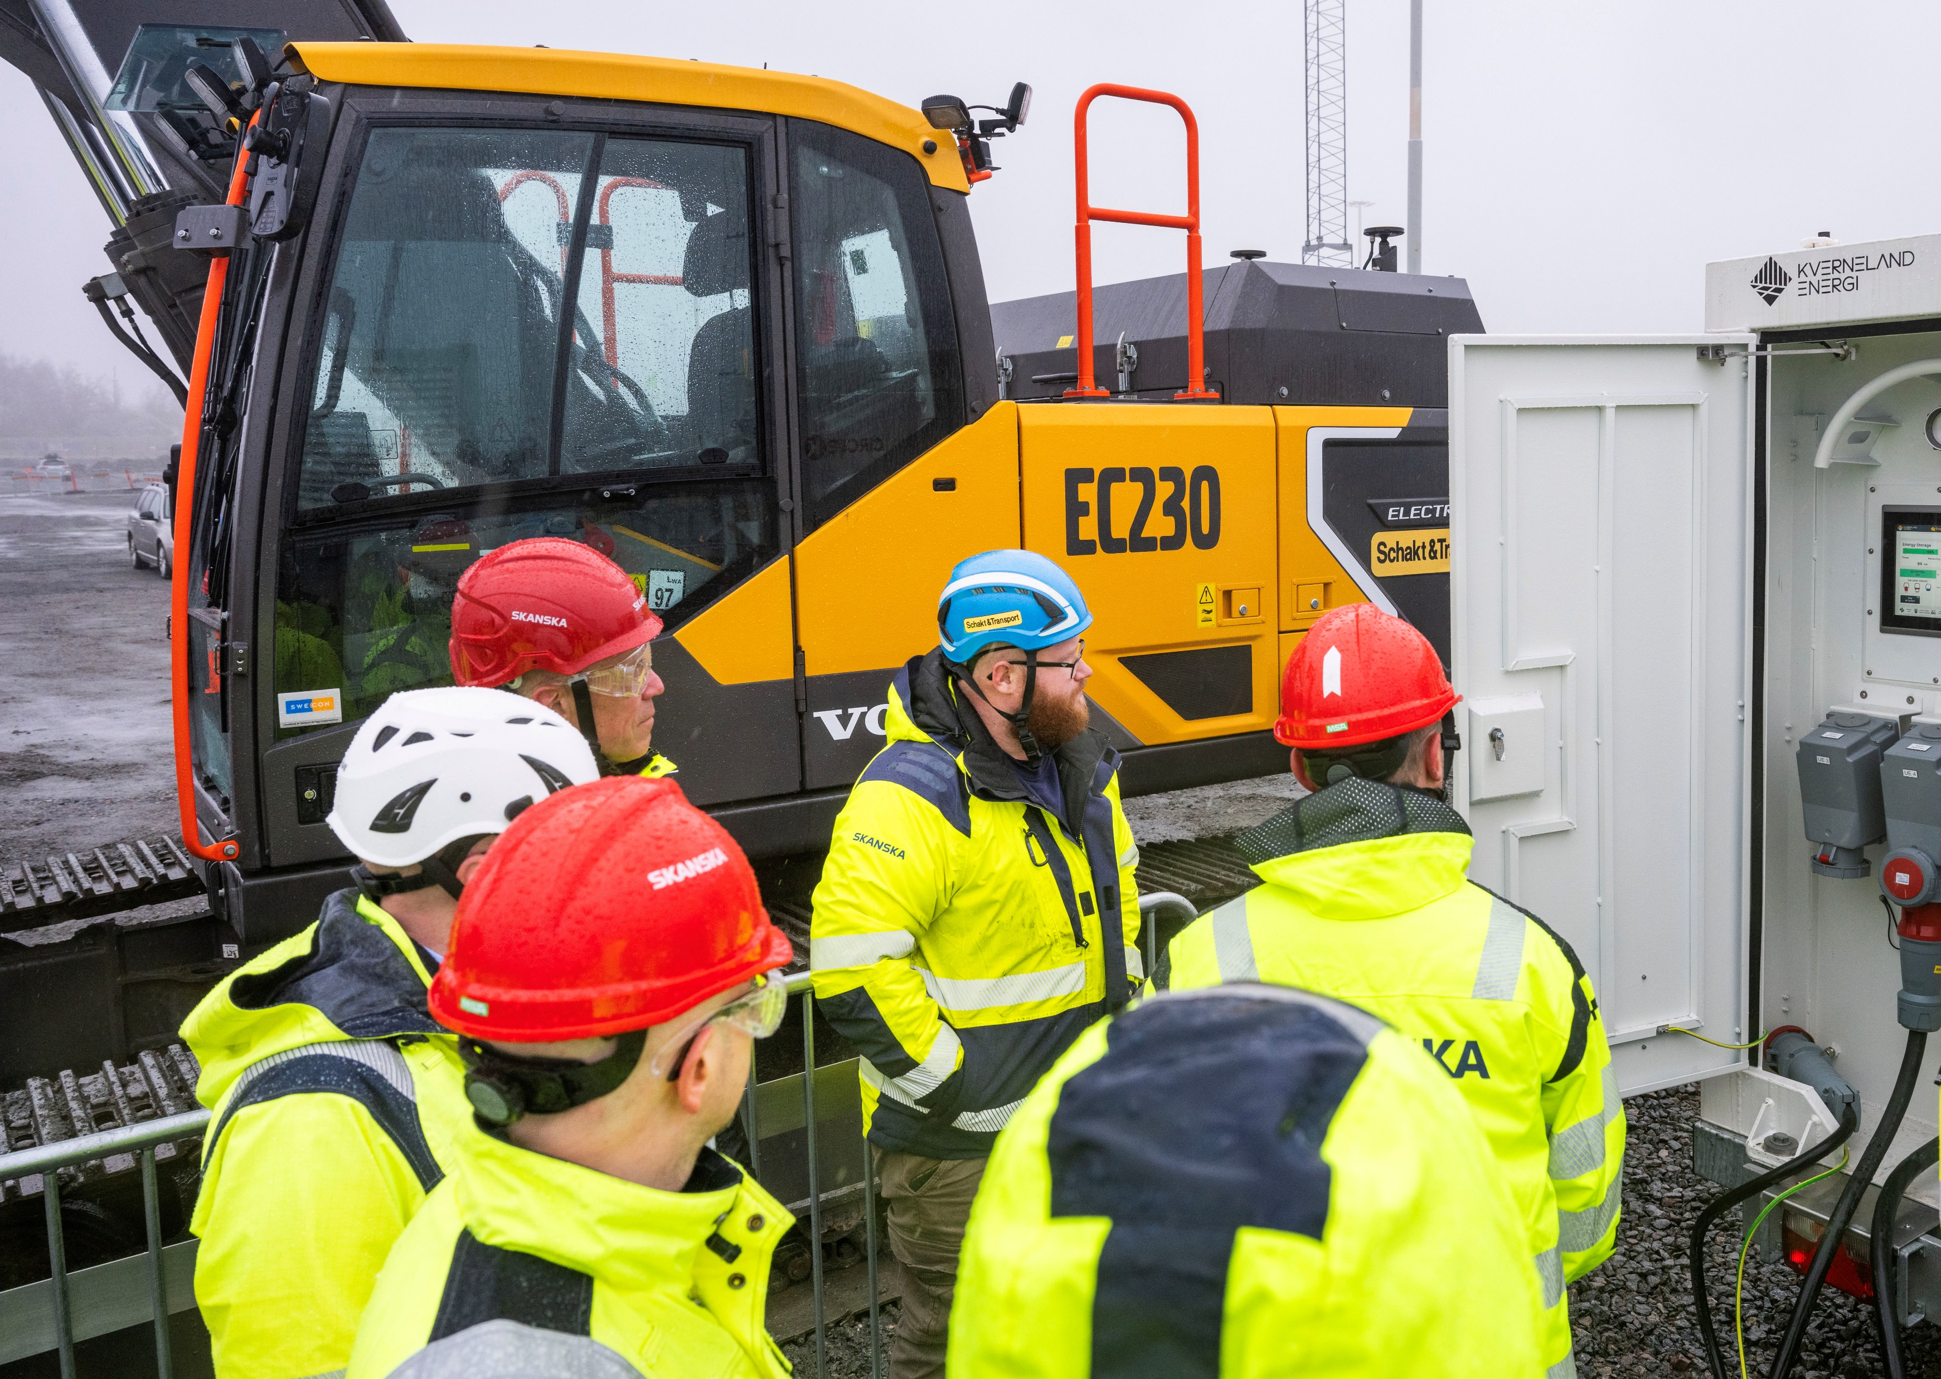
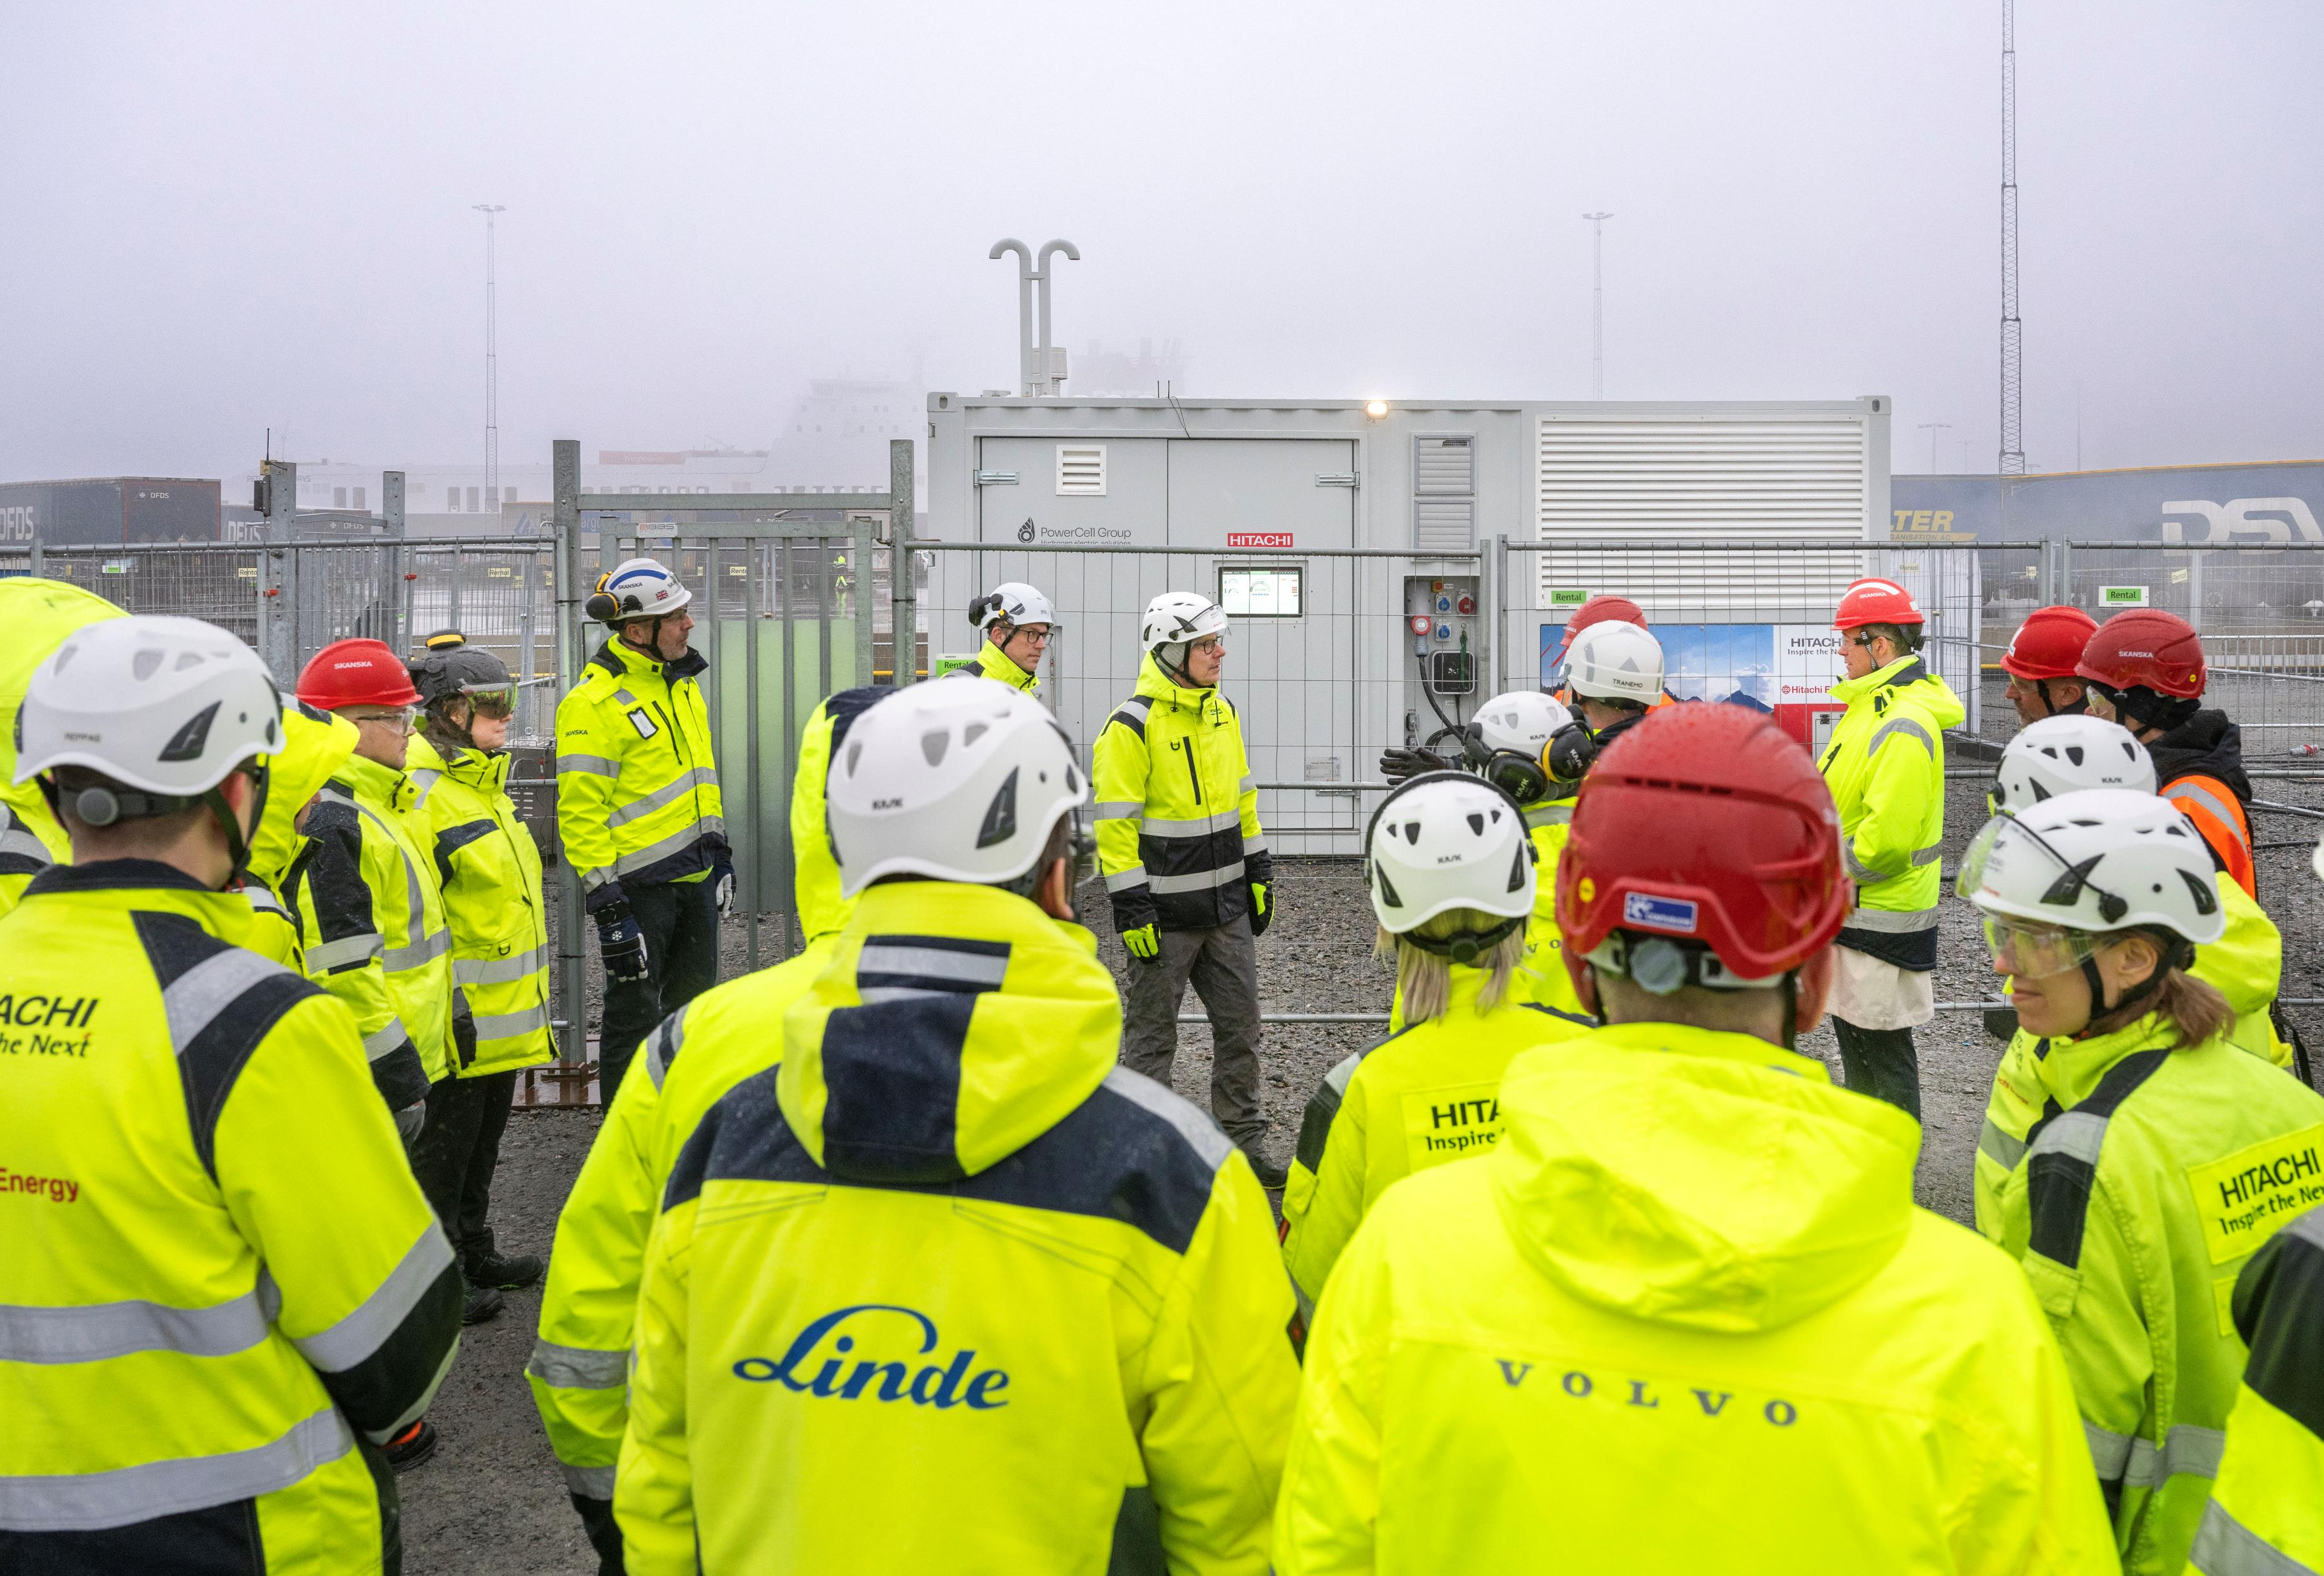
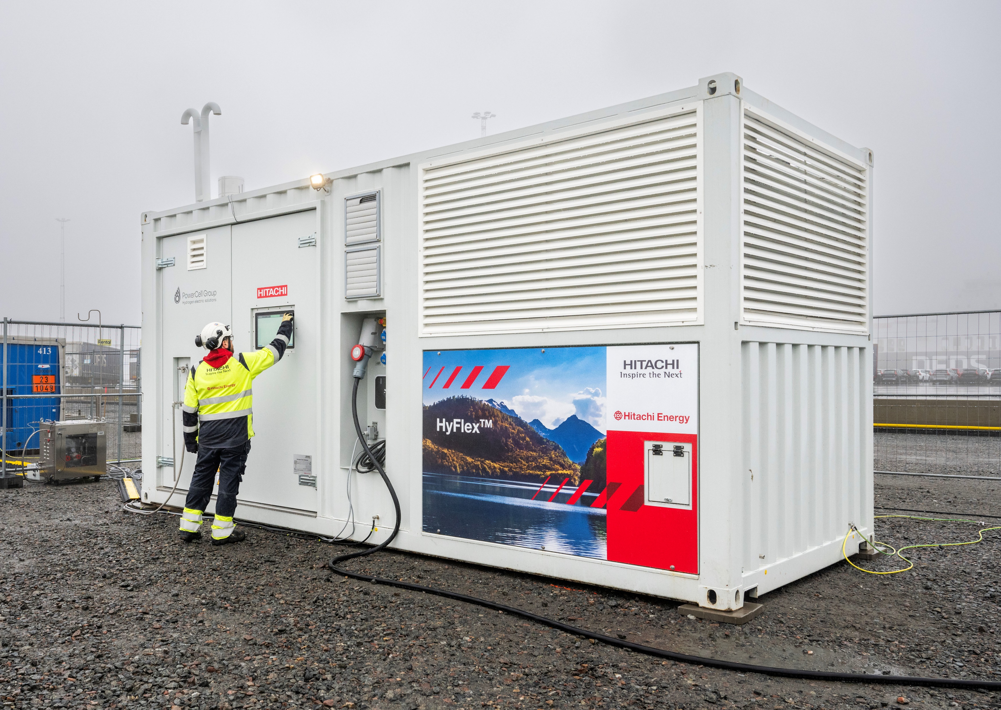
HyFlex customer trials – Gothenburg Harbor

Slide 13
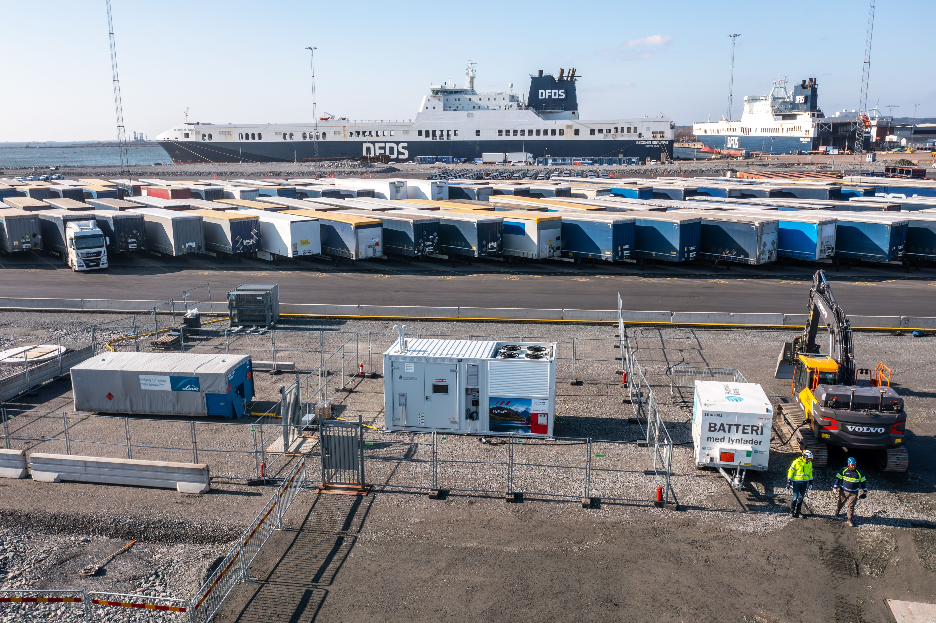
H2 storage bottles
HyFlex Hydrogen Power Generator
H2 safety and regulation panel
Batteries and e-excavator powered by HyFlex
Notes:
We produced 1 MWh and mitigated roughly 200 kg of diesel which is over 600 kg of CO2 which and consumed roughly 70-100 kg of H2. This was just a trial demonstration.

